Slide 1
New Year’s Resolutions
Activity ideas for ages 7-14
Notes:
At the beginning of the year, whether it’s the calendar or school year, people often reflect and set resolutions for the year ahead. The global pandemic has prompted many of us to reconsider our connections with those around us and what we value the most in life. It has also made many people think about how we can work together to create a fairer and more sustainable future for all.
The following activits can be used to help learners aged 7-14 years to reflect on their own role in their classroom, school community and as a global citizen; supporting them to decide on their own resolutions for the coming year.

Slide 2
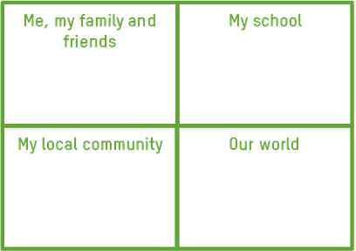
An ideal future

Slide 3
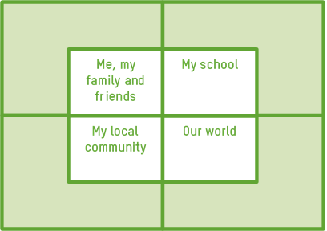
What can I do to make a difference?

Slide 4
Me
My resolution is to be kinder to others…
…let someone know why I appreciate them
…leave a positive message for someone else to find
…listen carefully to others
…contact a friend or relative I haven’t spoken to for a while
…smile at people more
…give kind comments to people
…accept differences of opinion

Slide 5
My school
My resolution is to help make our school welcoming to all…
…find out about the school’s equal opportunities policy
…design a welcome pack for new pupils
…learn words in other languages
…tell someone if I or someone I know is being bullied
…talk or play with someone I don’t know very well.
…be a buddy for a younger pupil
…find out about the UN Convention on the Rights of the Child

Slide 6
My local community
My resolution is to help others in my community
…find out about ways in which I could volunteer
…paint pictures to send to residents at a local care home
…donate food to a food bank
…donate my unwanted clothes, books and toys to a local charity shop
…research an issue affecting my local community
…try to buy locally and support independent shops near me
…do a beach clean or litter pick

Slide 7
Our world
My resolution is to take action to tackle the climate crisis
…write to my MP or local businesses about the importance of taking action now
…plan and deliver an assembly to raise awareness
…eat less meat and dairy
…organise a school week of action
…set up a school garden or wildlife area
…research some of the amazing ways in which people around the world are taking action
…try to walk or cycle more

Slide 8
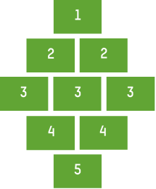
Ranking actions

Slide 9
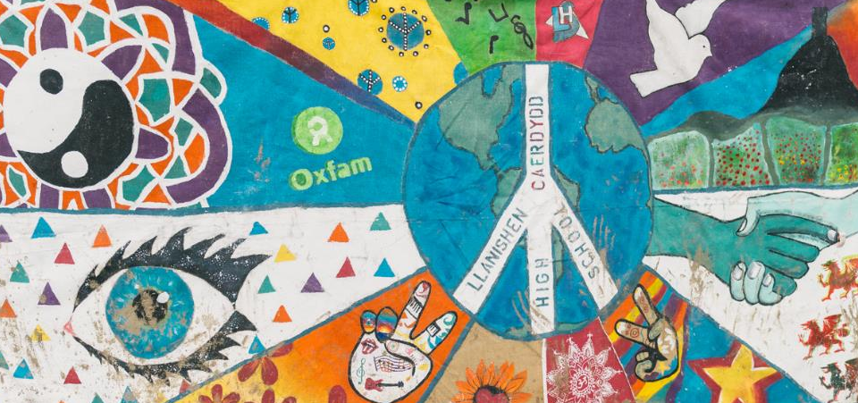
‘You may never know what results come of your actions, but if you do nothing, there will be no results.’ Mohandas Gandhi
Notes:
One of the murals created by schools for Oxfam’s Stand as One campaign and displayed at Glastonbury Festival.
Photo: Sam Baggette/Oxfam

