Slide 1
THE HUMAN IMPACT OF CLIMATE CHANGE
Images used in the activities
Notes:
With curriculum links to geography and citizenship, this flexible teaching resource for ages 11-16 focuses on the human element of the climate crisis
Investigate the links between climate change and human rights.
Explore intersectionality and its relevance to the climate emergency.
Use films from around the globe to explore climate change impacts and potential solutions.
This accompanying slideshow displays the images referred to in these activities.

Slide 2
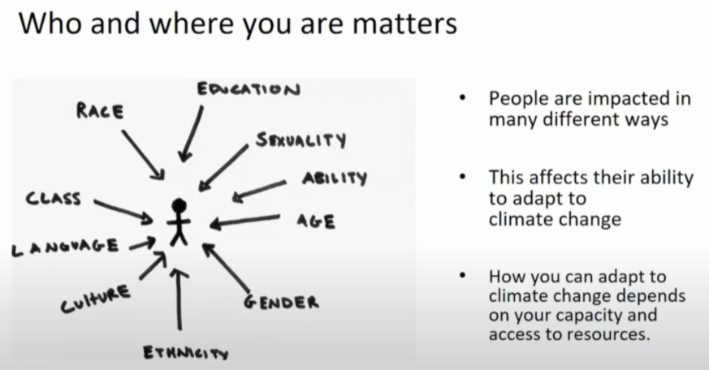
Notes:
Image: From Kate Crowley at the Scottish Climate Citizen’s Assembly, Nov 2020, 12:03 mins into this talk: https://youtu.be/-4eLuFDslAM

Slide 3

Notes:
Image: https://www.un.org/sustainabledevelopment/news/communications-material/

Slide 4

Notes:
Image: UNCRC Article 2 – ‘All children have these rights’: https://cypcs.org.uk/rights/uncrc/articles/article-2/

Slide 5
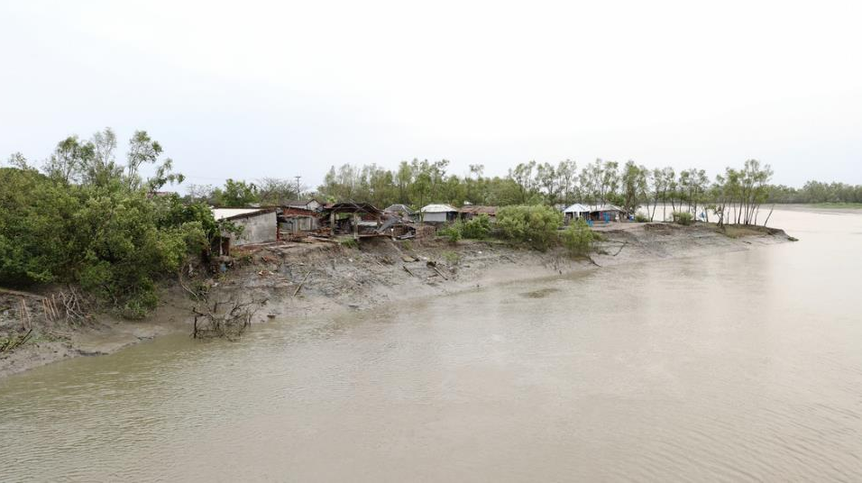
Notes:
Image: Fabeha Monir/Oxfam – Bangladesh, November 2019.

Slide 6
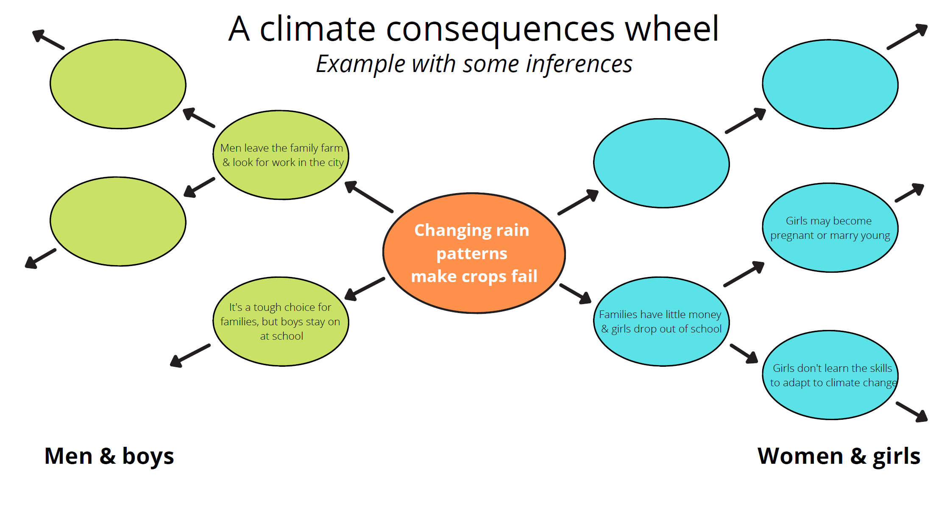
Notes:
Adapted from: Oxfam (2015) – ‘Global Citizenship in the Classroom’ p.15 - https://oxfamilibrary.openrepository.com/handle/10546/620105

