Slide 1
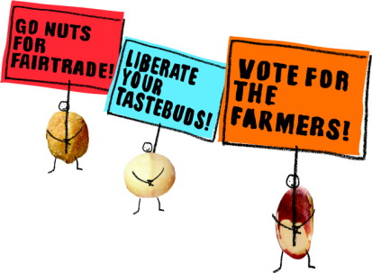
Children Like You
Notes:
When people think of Fairtrade they usually think of bananas or coffee or maybe tea or chocolate… but over the past few years a new Fairtrade market has emerged – for nuts. People are literally going NUTS for Fairtrade!
At the centre of this is a new company which is completely focussed on the farmers and gatherers who produce the nuts and marketing their produce into nutritious and tasty products for European consumers. Us.

Slide 2
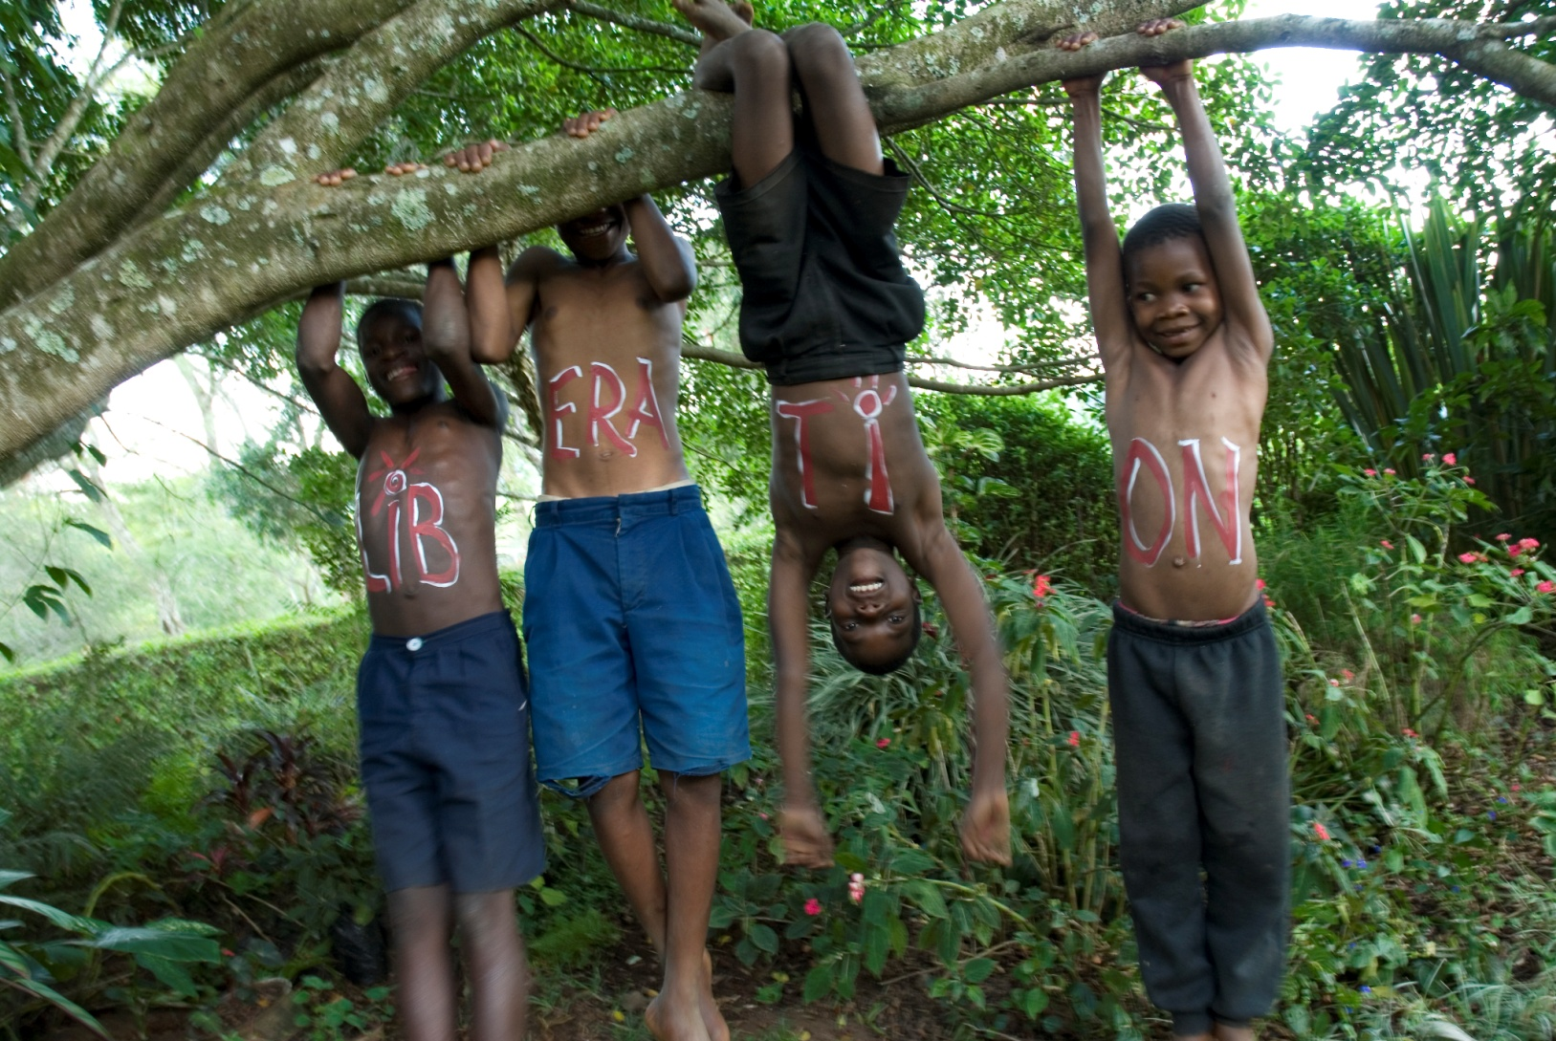
Liberation is...

Slide 3
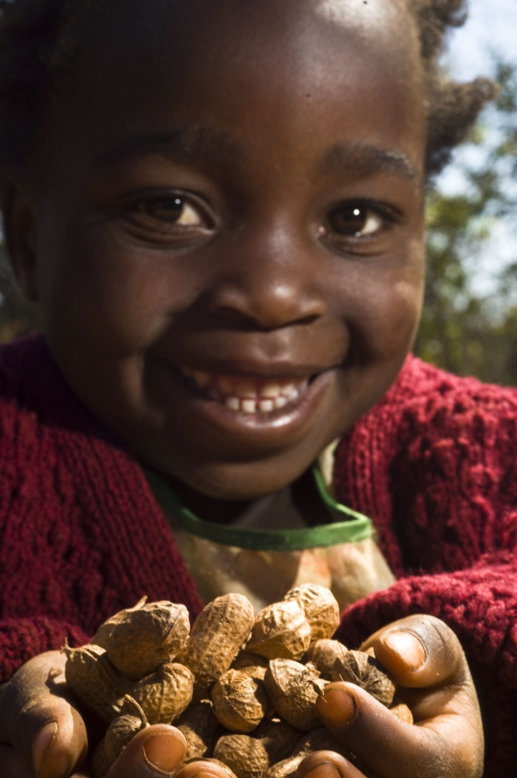
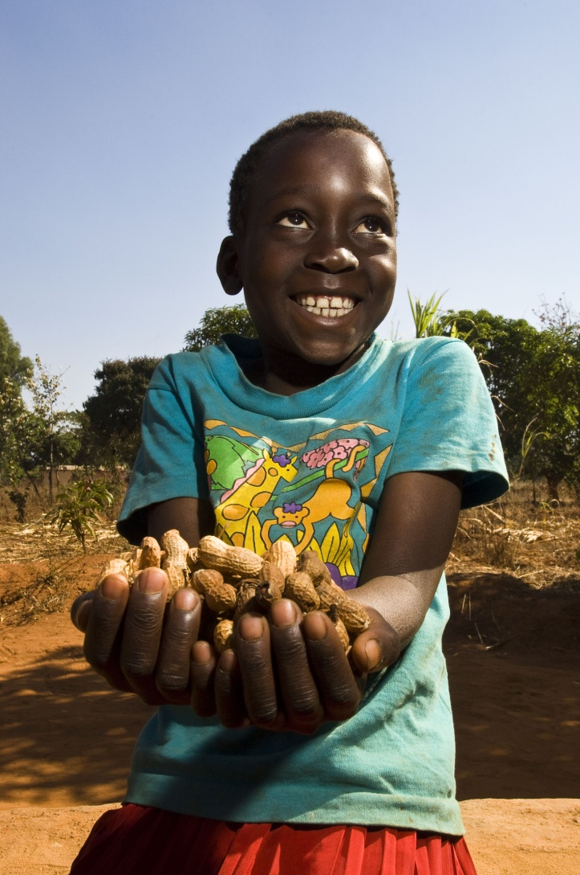
‘Nuts about…
Kamwendo
Mchinji

Slide 4
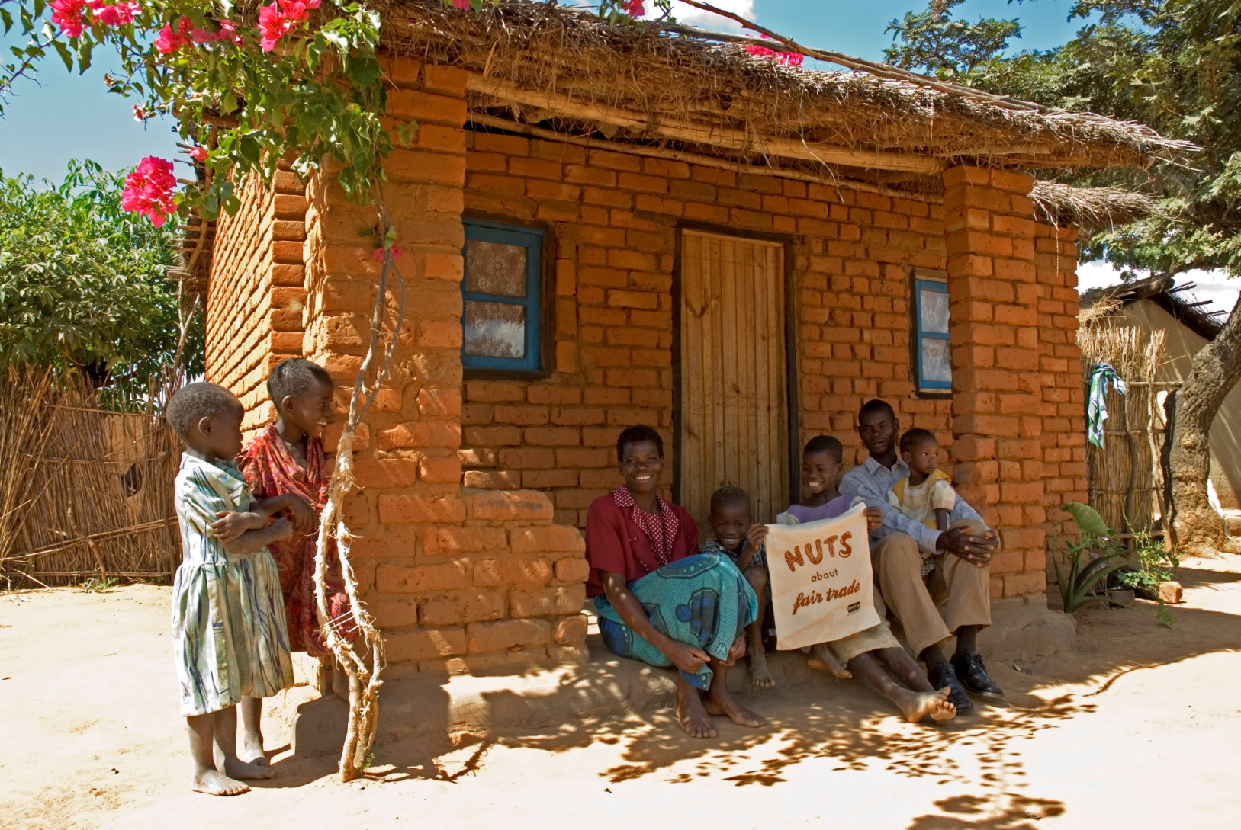
…FAIRTRADE’

Slide 5
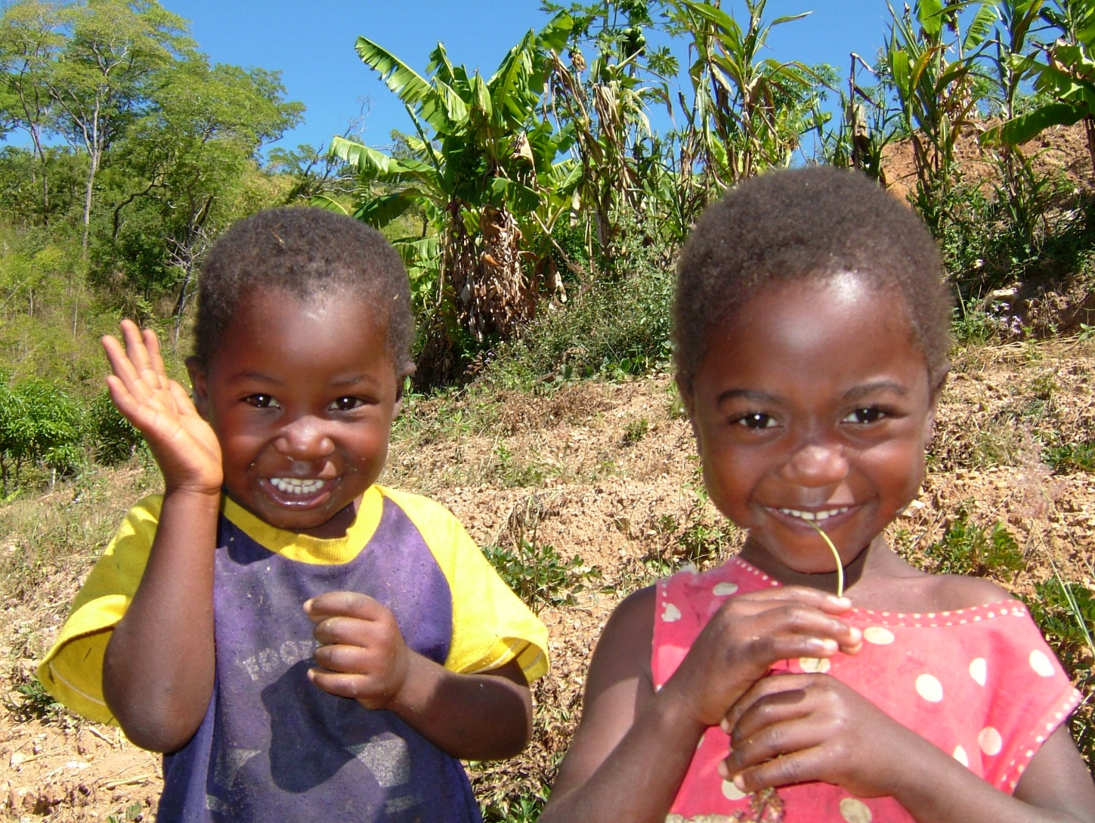
…because children like you need:

Slide 6
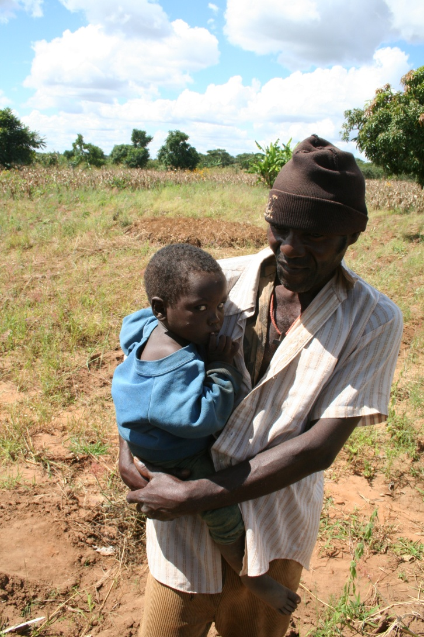
People who care

Slide 7
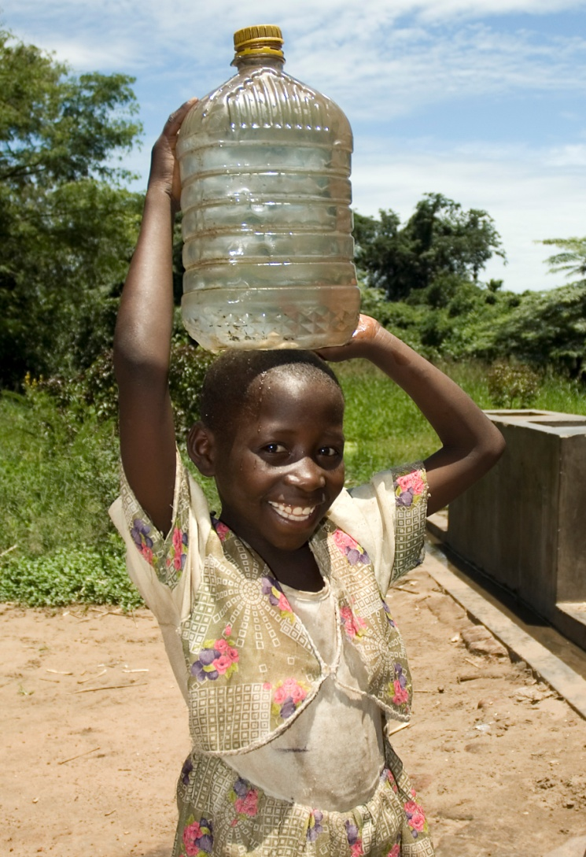
Water

Slide 8
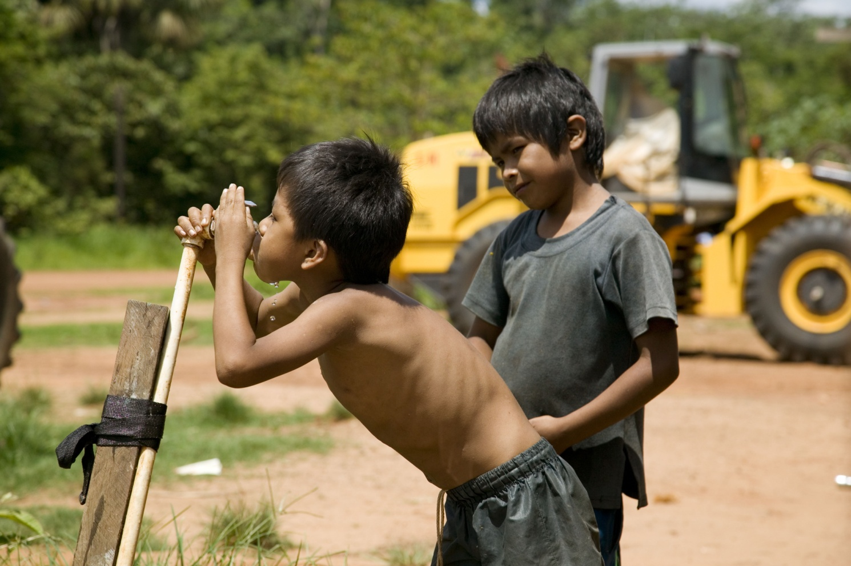
Water to drink

Slide 9
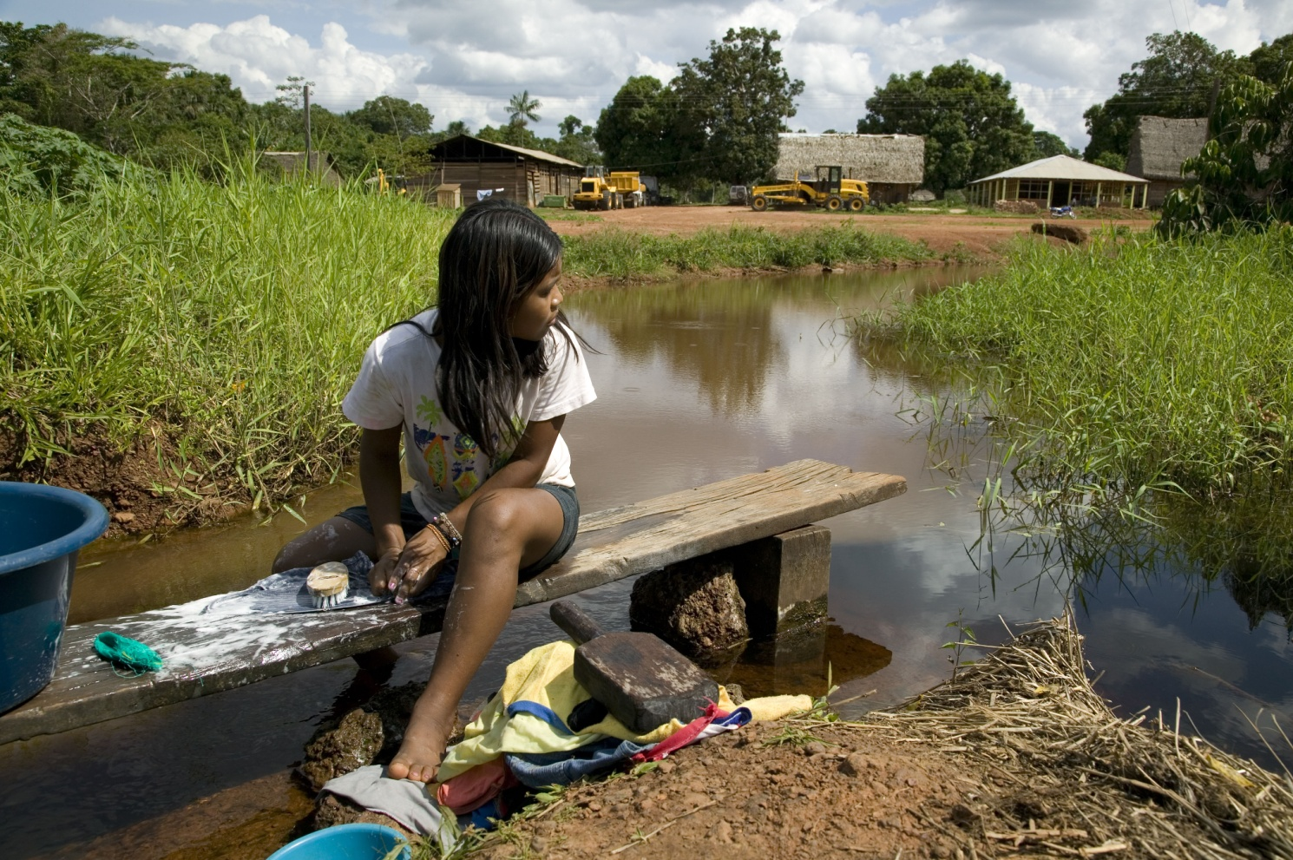
Water for washing

Slide 10
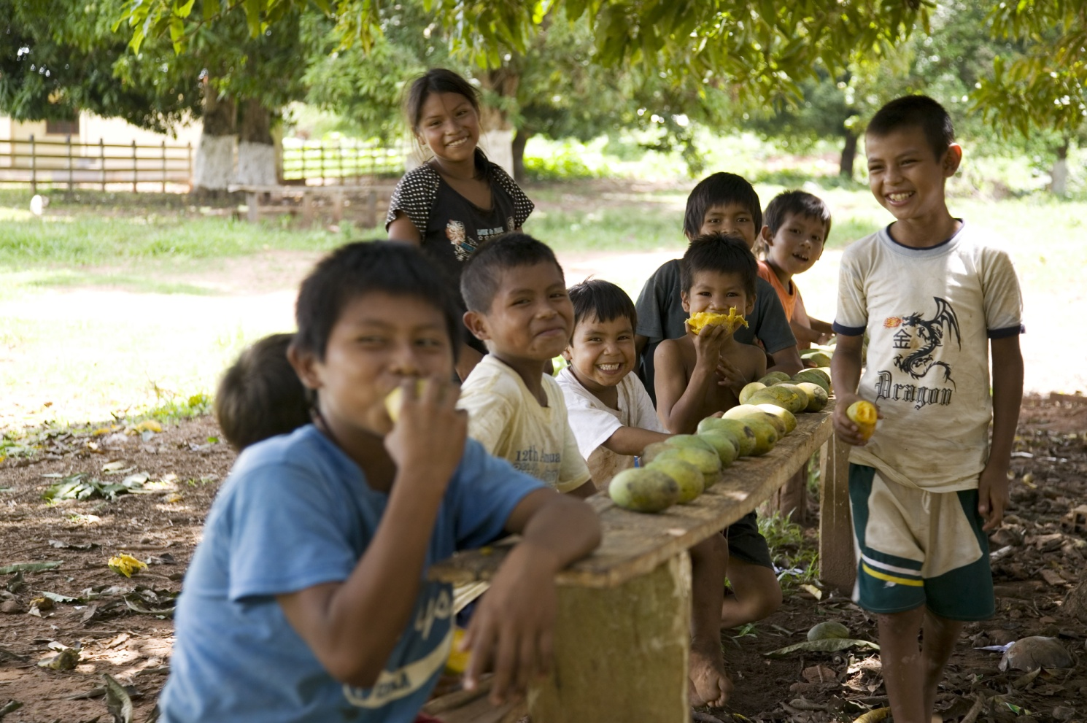
Food

Slide 11
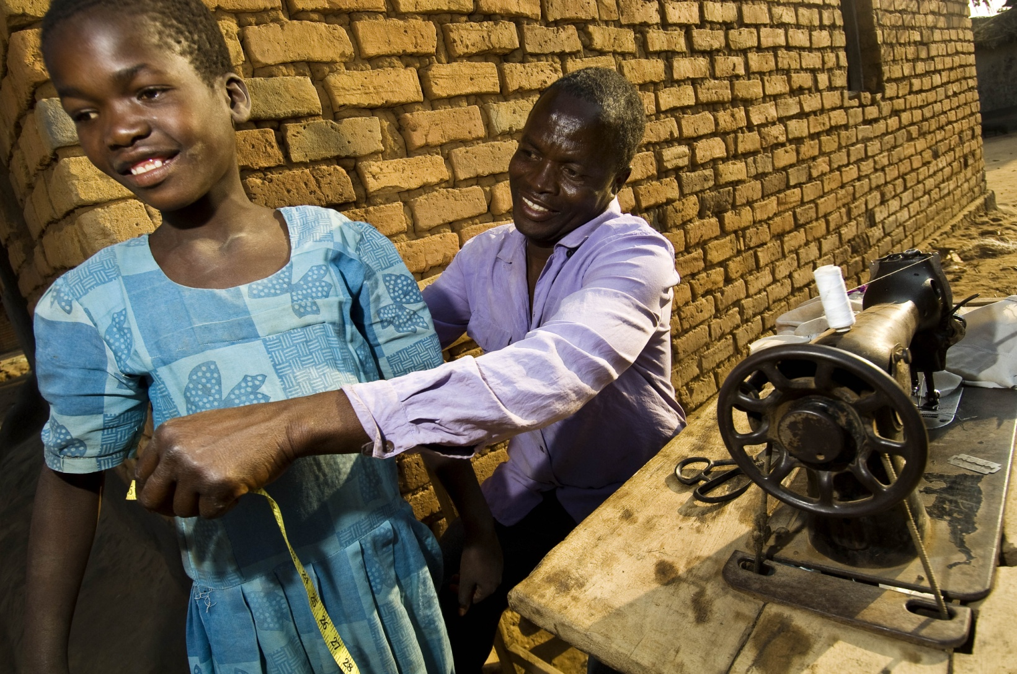
Clothes

Slide 12
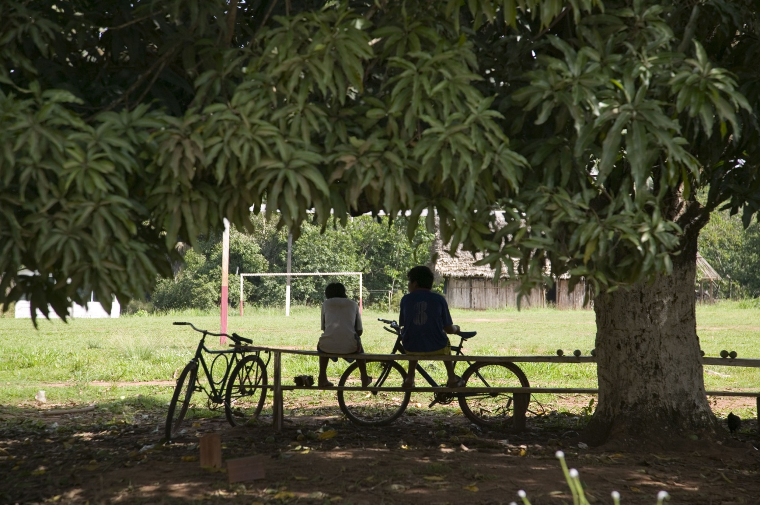
Somewhere to relax

Slide 13
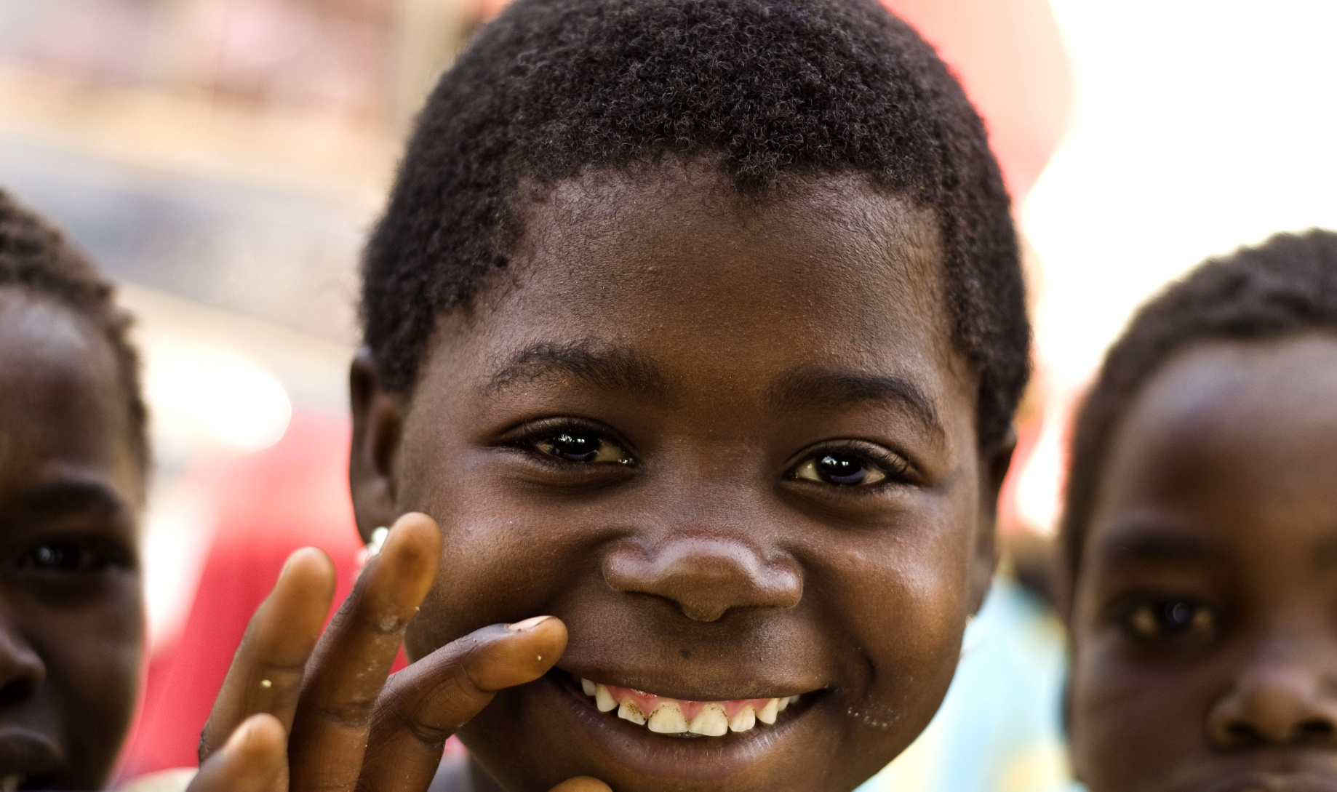
Friends

Slide 14
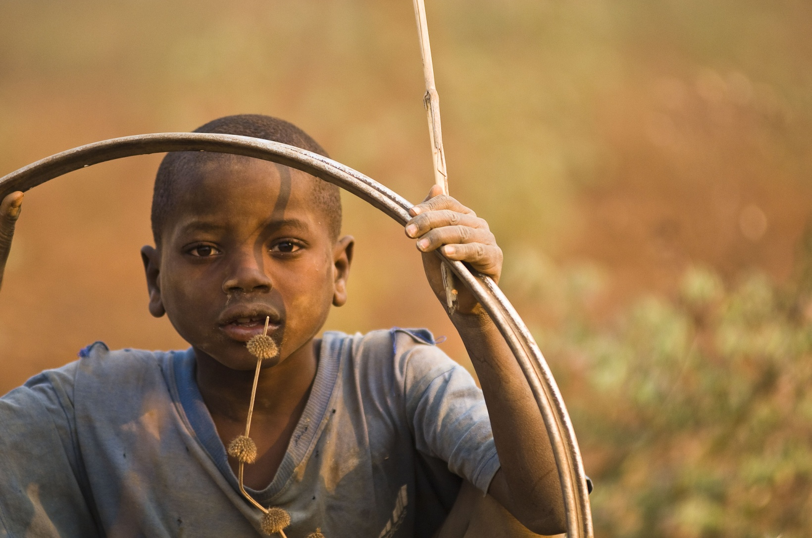
Toys

Slide 15
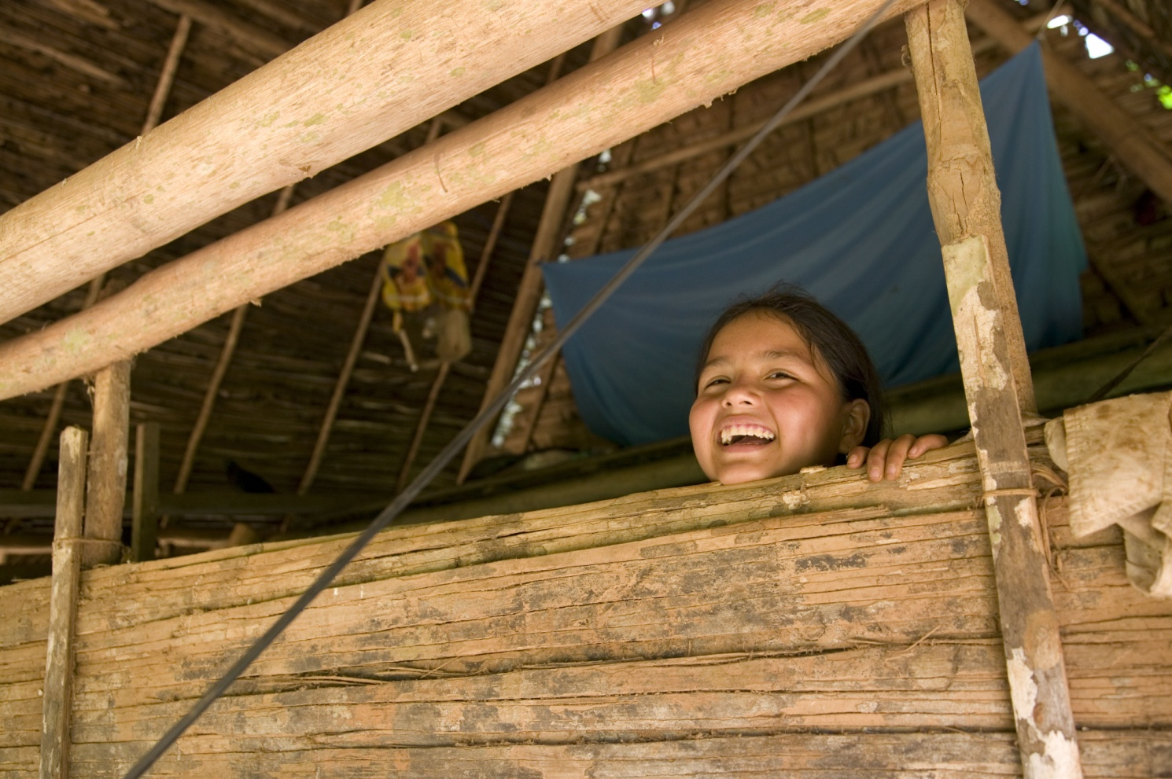
Hiding places
Paola Riveres

Slide 16
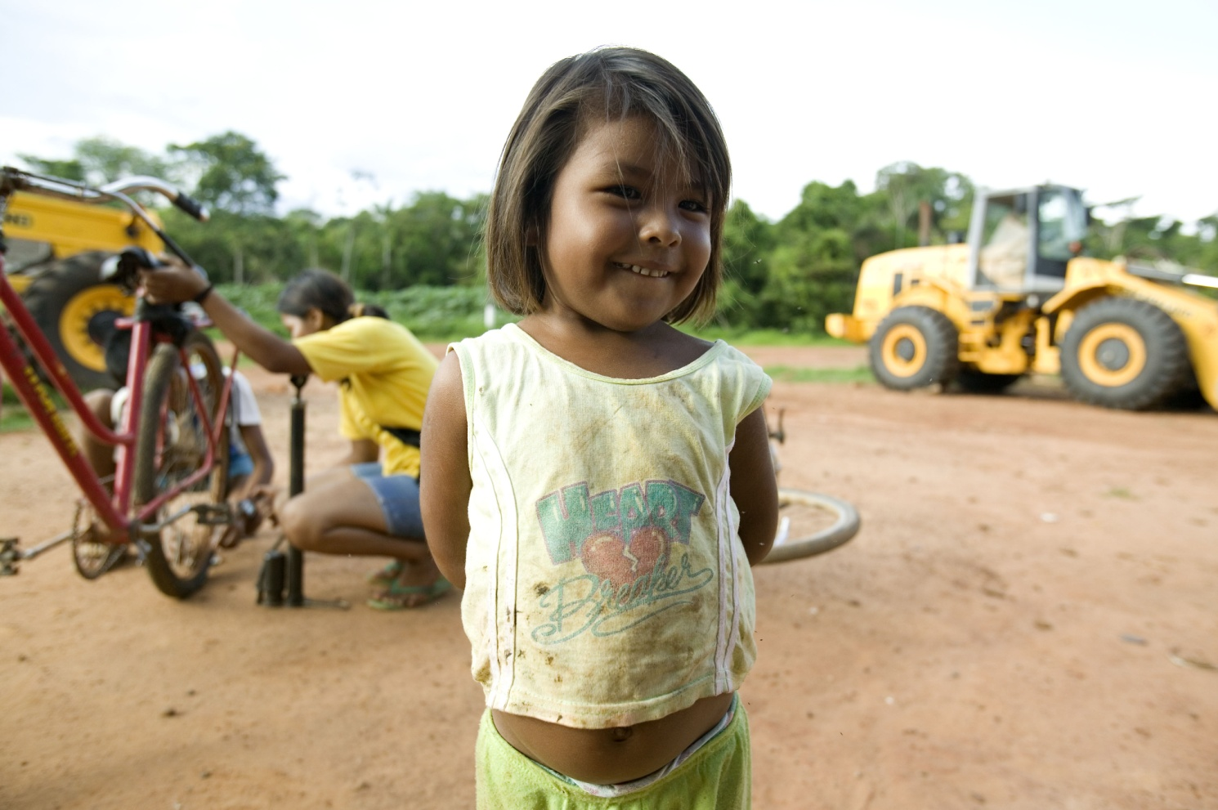
To feel proud,

Slide 17
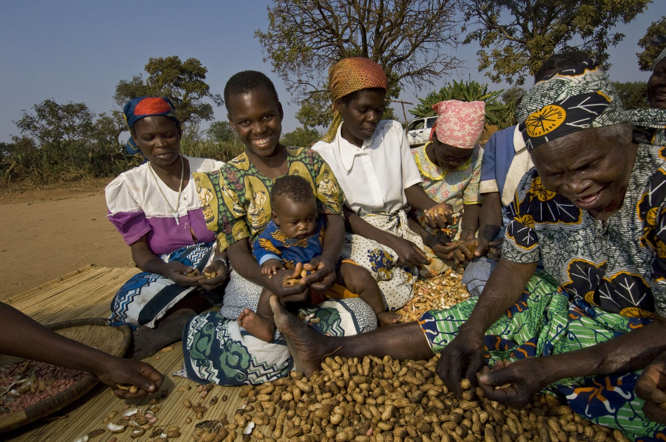
included,

Slide 18
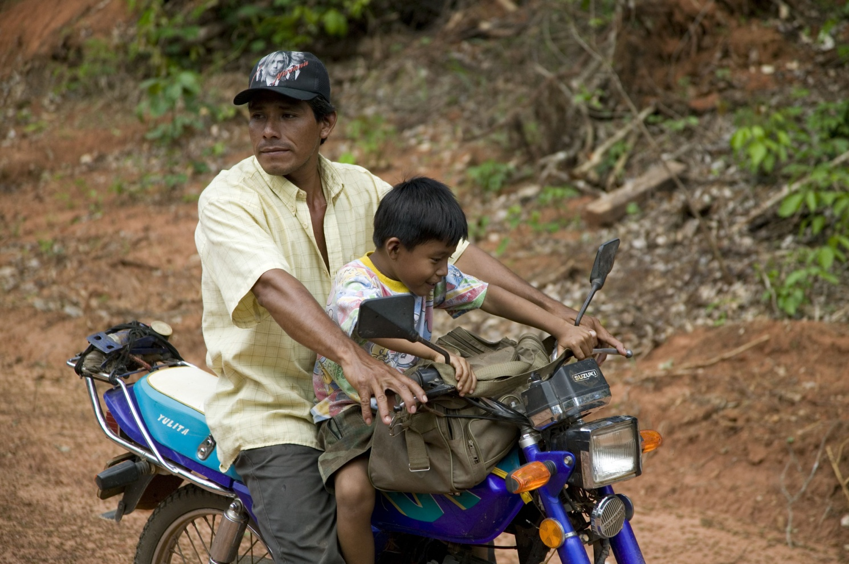
and in control.

