Slide 1
Stories of loneliness

Slide 2
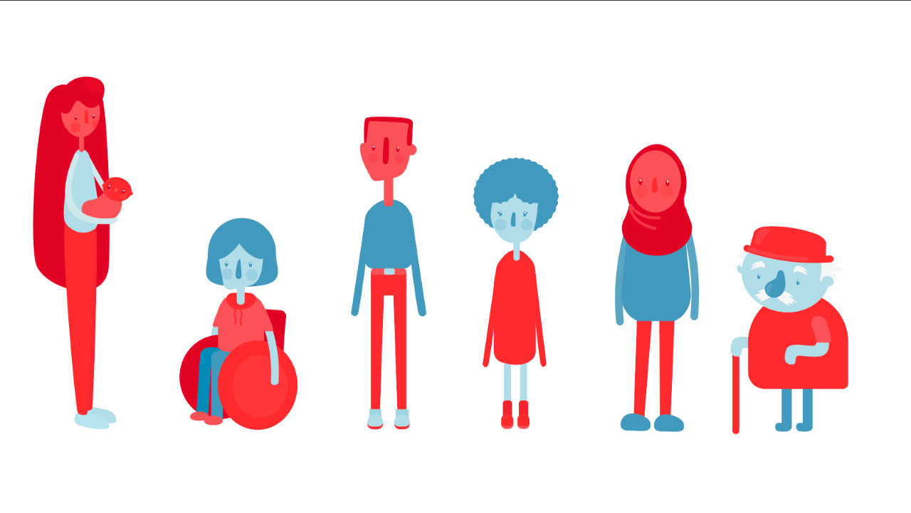
Meet the characters

Slide 3
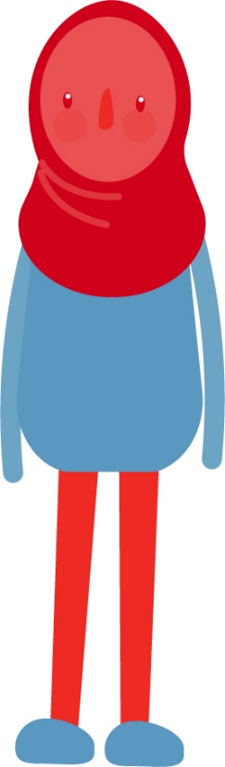
Ari
Ari has just moved house - 150 miles away from the place she calls home. ​
She used to walk to school now has to catch the bus (moved to rural area). ​
At her school she was a member of the Science and French clubs, and played on the football and rounders teams. She has not joined anything yet at her new school – they do not have the same activities available and she’s not sure if she can get home afterwards. ​
She has met her neighbour (Mr Phillpotts) but knows no one else in the village.

Slide 4

Riley
Riley lives on the outskirts of the village and attends the same school as Darby and Ari. Riley is a carer for their dad who has some health issues.​
They takes on a lot of responsibility at home and the two of them have become isolated from other family members and their local community. Riley constantly worries about their dad and had started to find themselves becoming more and more anxious about life. Riley gets told off a lot at school for being on their phone. ​
Riley seems quite shy and often distracted on the bus to school.

Slide 5
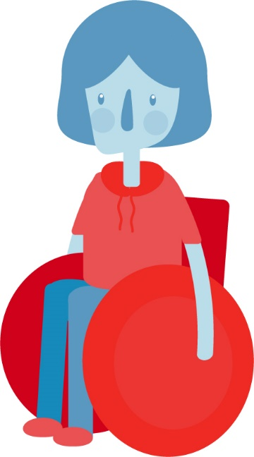
Elis
Elis lives in the village. She always looks tired. She appears not to eat well as she has an energy drink every morning. She does not appear to have many friends. ​
She is a gamer and has niche interests which makes them seem ‘strange’ to other people. She has lots of friends online and in different countries that she speaks to who share her interests.
Although she enjoys her own company, she sometimes feels others don’t understand her.

Slide 6
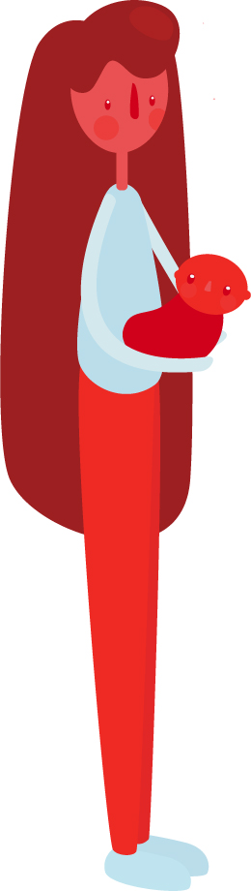
Fia
Fia is 18 and has just had a baby and lives independently. She split up with her boyfriend 6 months ago. She lives 45 minutes from her brother Darby and her family but does not want to bother them constantly. ​
All of her friends are at college and university and she feels like they do not understand. She wants to go to university too but isn’t sure if she could do it.
The baby is with his father every other weekend and then she feels alone in the flat.

Slide 7
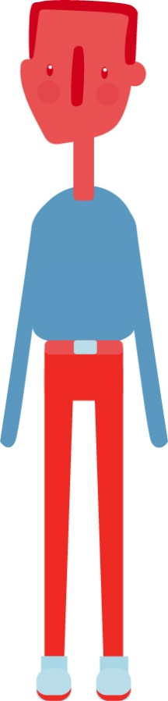
Darby
Darby lives in the village with his parents and his 2 younger sisters. His older sister Fia has moved into a flat after having a baby. ​
He gets the bus with Ari to school but is always rushing as he takes his sisters to school first. He is in the same year as Ari. He likes football and Geography.
He feels a lot of pressure to help take care of others and is worried about showing other people when he is struggling.

Slide 8
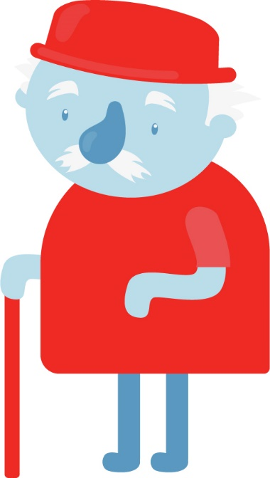
Mr Phillpotts
Mr Phillpotts lives next door to Ari and her family. He used to live in the city, but came to the village to retire. He has some land with a few chickens and a goat. ​He had the dream of opening a petting zoo.
His wife passed away last year and he does not go out much anymore. He loves to do jigsaws and cryptic crosswords.​
He has two sons who live out of the local area who visit occasionally.

Slide 9

Add to or change these stories. Think about other situations that may make people feel lonely

