Slide 1


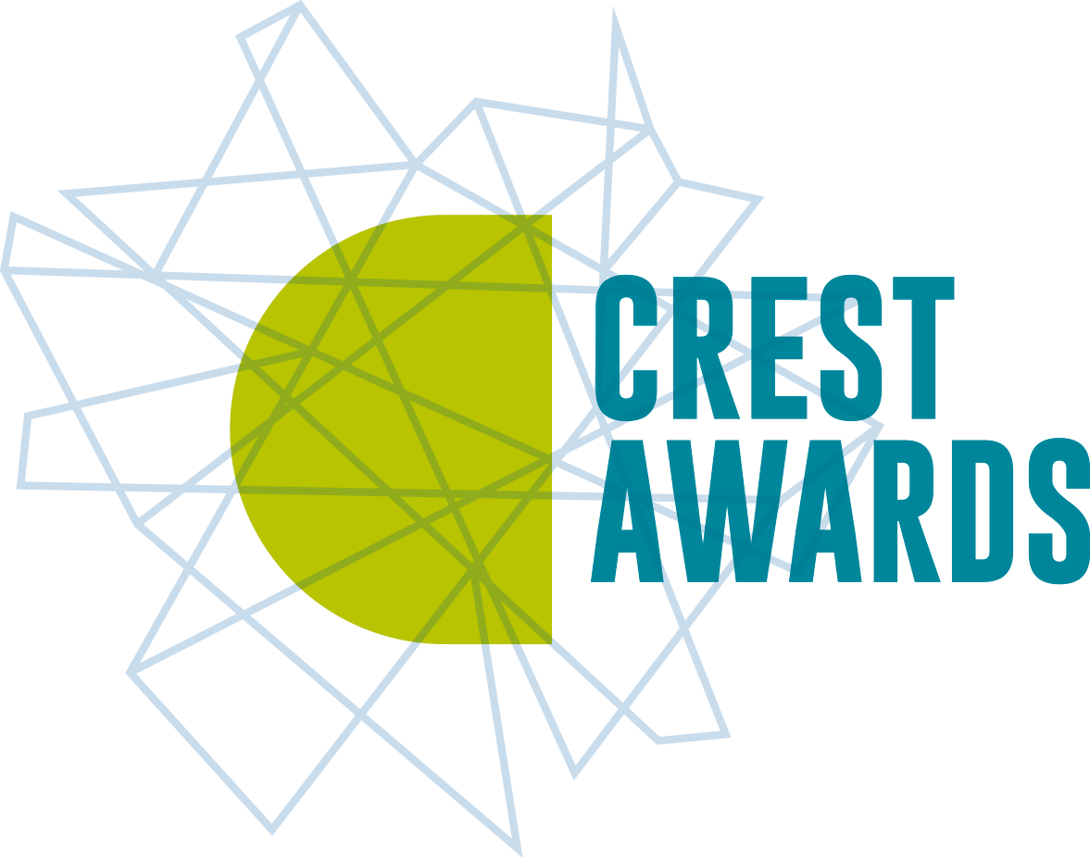
Smoky
HOMES
Notes:
The pupil activity sheets to accompany the project can be found here www.practicalaction.org/schools/smoky-homes.

Slide 2
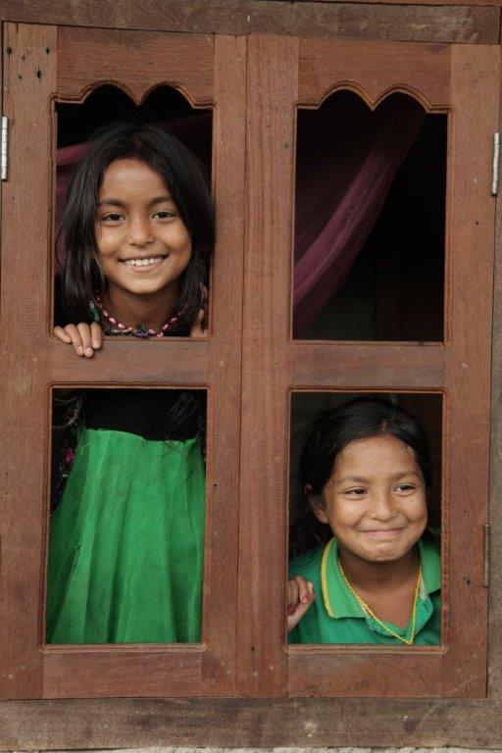

Life in Nepal
Sisters Shanoli and Rensi live in a small village in Makwanpur District in Nepal.
Their family has just finished rebuilding their home after it was destroyed by the earthquake in 2015.
Before the earthquake, they had a traditional stove their home.
'Although it produced a lot of smoke which made us cough, it was less smoky than the open fire using three-stones or bricks our grandma now uses to cook for us.
2

Slide 3
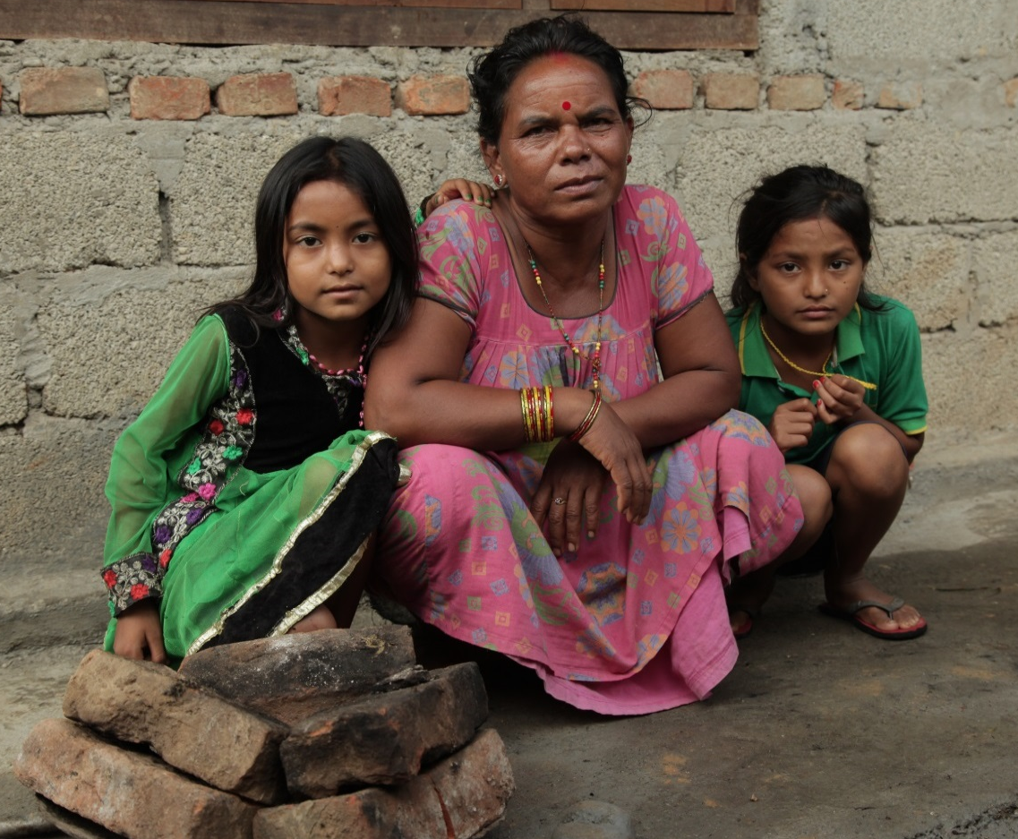
Cooking for our family
Bimala is the girls grandma. She cooks for all ten people in the family.
‘I always cook outside our home. If I don’t the children and I get breathing and eye problems caused by the smoke. Everything in the house gets dirty too.
In the monsoon season I use an umbrella to stop the fire from going out before our food is cooked. '
3

Slide 4
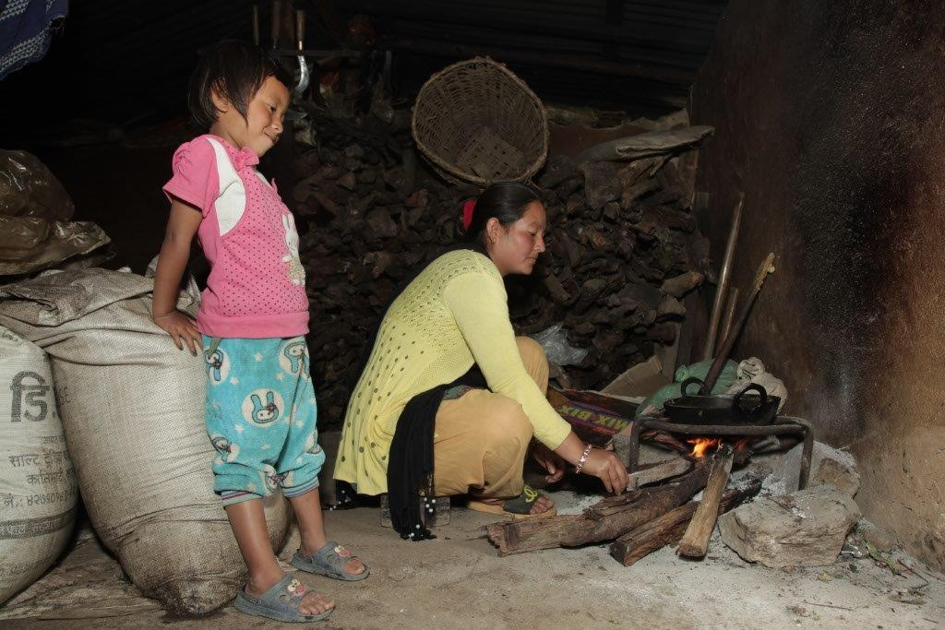
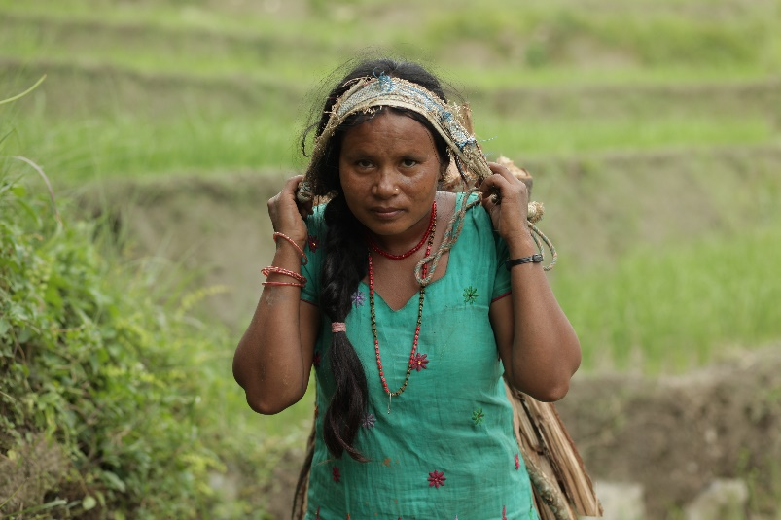
What do you see?
Look at the photographs from Nepal and identify any problems that you think traditional cooking methods cause for people and the environment.
4
Notes:
You might like to show the first 1.27 mins of a video clip to show some of the problems caused by traditional cooking methods in Nepal. http://www.youtube.com/watch?v=y0HXGqHvbUM

Slide 5
Killer facts: True or false?
Check your answers as to whether your Killer facts were true or false.
Indoor smoke from fires is a bigger killer than AIDS and malaria combined.
True (4.3 million people die from it each year)
Most people affected by indoor air pollution are women and children.
True (as more women and children are involved in cooking)
3. An open fire in your kitchen is the equivalent of breathing in the air from 200 cigarettes an hour.
False (the real fact is 400 cigarettes per hour)
4. 3 billion people worldwide cook or heat their homes over an open fire or traditional stove.
True
Globally half the deaths of children under 5 are caused by respiratory problems, such a pneumonia, caused by household air pollution.
True
There is nothing that can be done to stop indoor air pollution. False
5
Notes:
Facts available sourced from fact from WHO 2016 factsheet and http://www.who.int/features/2014/clean-household-energy/en

Slide 6
Sustainable Development Goals
Notes:
The Sustainable Development Goals (SDGs)
This slide shows the full set of Global Goals with their icons. You can download a Sustainable Development Goals pupil sheet showing the goals and their targets. This and other Global Goals activities can be downloaded here practicalaction.org/schools/sdgs

Slide 7
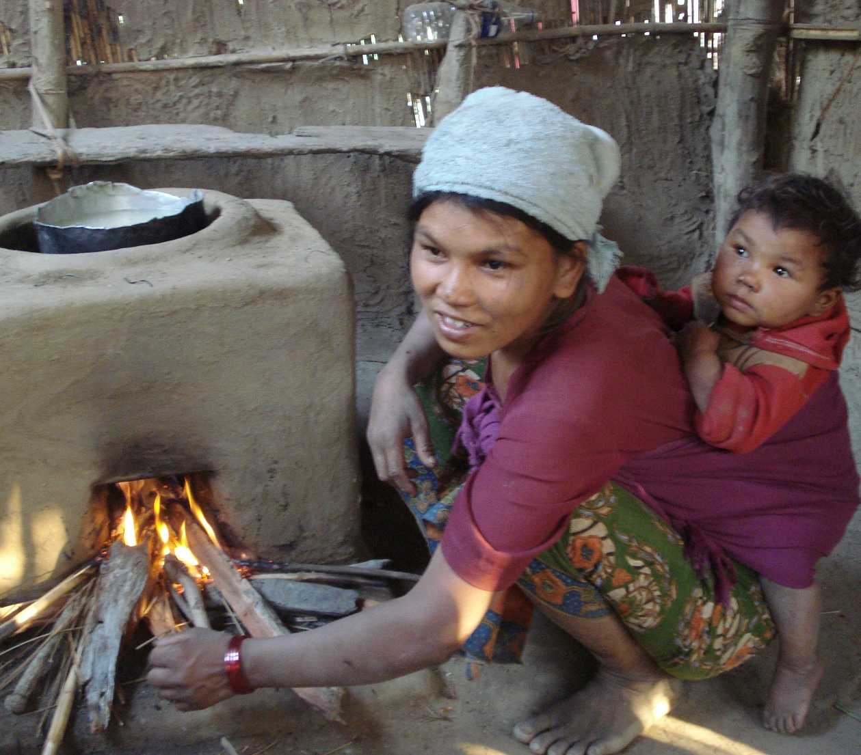
Global goals
In 2015, an organisation called the United Nation held a meeting with leaders from over 30 countries to address some of the world’s biggest problems.
One of the problems was how many people in the world are suffering from illness caused from inhaling household smoke.
The action needed to address the problems were turned into the Sustainable Development Goals (SDGs) or Global Goals for short.
7

Slide 8

The Sustainable Development Goals
Notes:
The Sustainable Development Goals (SDGs)
This is the full set of Global Goals.
We recommend that you use the pupil sheet Sustainable Development Goals, so that pupils can consider which of the goal targets could be reached by addressing problems caused by plastic waste.

Slide 9
Smoky Homes
Design and make PROJECT
Notes:
Smoky homes Design and make pupil sheets are available to support this design and make activity

Slide 10

Rensis’ idea!
'I’d like us to have an improved cook stove so that we can cook our meals indoors. I have seen one at my friend’s house and would love to have one.
They also have a smoke hood so the smoke goes out of the house.
If we had one, it would be less smoky in our house and take us less time to cook meals. That would mean I could study more and my grandma would have more time to take care of our cattle. ‘
10

Slide 11
Design and make project
Design and make a model of an improved cook stove and/or stove hood for a family such as Rensis’.
Use the activity What is important to the community? to help you decide on the most important features to include in your design work.
Evaluate any cook stoves and hoods that have been developed in the past.
Develop a range of design ideas for a cook stove and/or hood, then decide on a final idea to develop into your model.
Use a range of modelling materials to make your model cook stove and stove hood.
Evaluate your final model against your design criteria using the Evaluation web
Present your project to your class, include – How you worked as a team, Your design ideas, final model (or design) and how you would change it if you designed or modelled it again.
11

Slide 12
Feedback
Team work
How well did you work together?
Research
What did you find out?
Developing ideas
What ideas did you try out and how did you change your design as a result?
Final design and/or model
How successful was it?
How would you improve it if you had more time
12

Slide 13
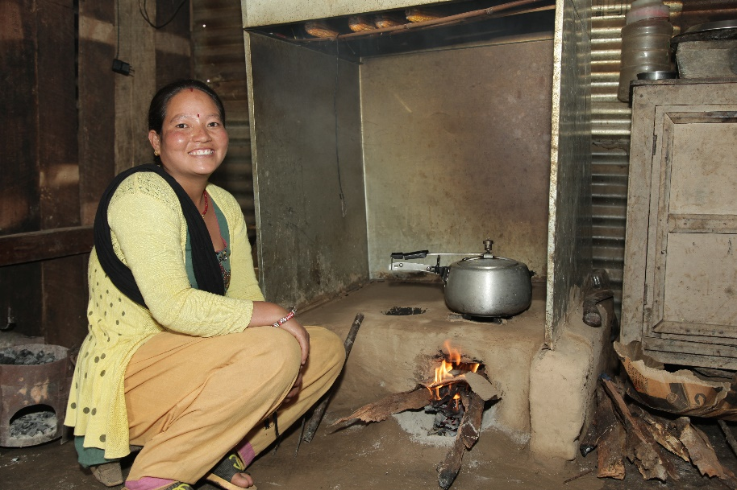
Ingenious solutions
In Nepal, Practical Action is helping to develop solutions to the problems caused by cooking on fires and traditional stoves.
A range of improved stoves and smoke hoods have been trialed and tested and some families have them installed in their homes.
The smoke hood draws the smoke from the stove and directs it out of the house.
This improved cook stove made from mud and clay uses 50% less firewood than cooking on an open fire.
13
Notes:
You might want to show the solutions developed by Practical Action in this video clip from 1.27mins to 3.50mins. http://www.youtube.com/watch?v=y0HXGqHvbUM

Slide 14
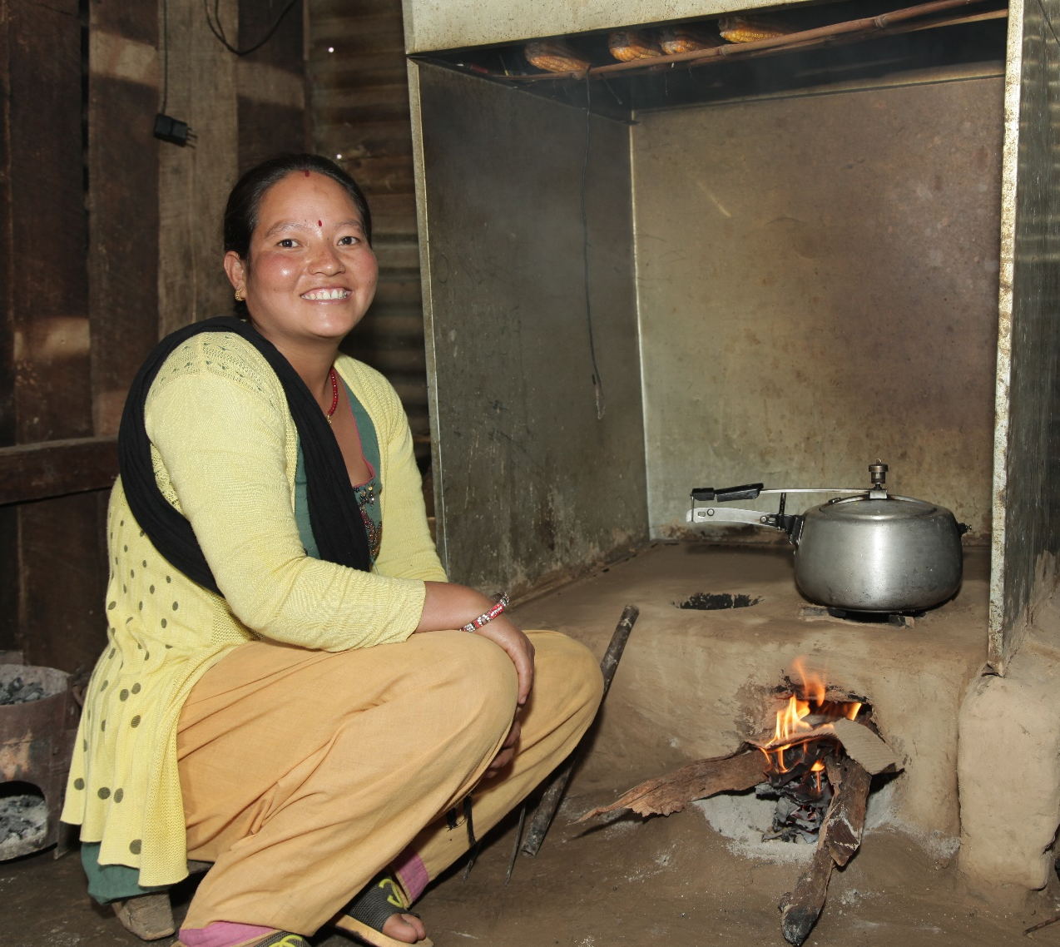
Making a difference
'My family are finding that the improved stove and smoke-hood is making a big difference our lives.
Before I had this new stove, I used to spend 3 hours a day collecting firewood.
This improved stove is more efficient and uses half the wood, so gives me more time to farm.
I also get more time to spend with my children and to help them with their homework.
The main thing is that we are now free from smoke related illnesses. '
14

Slide 15
Smoky homes quiz answers
How many people in the world cook on open fires?
b. 3 billion
What is the main problem for people with cooking on an open fire?
b. Inhaling smoke
3. Which of these other problems are caused by cooking on open fires?
c. a and b
4. In Nepal who mainly gets affected by smoke from cooking on open fires?
a. Women and children
5. Using a smoke hood over an open fire means you have less indoor smoke.
How much less?
b. 80%
Using an improved stove and smoke hood reduces the amount of firewood needed for fuel so that:
c. Less time is spent cooking
7. Which of the Sustainable Development Goals do the improved cook stoves help reach?
c. Both Goals 3 and 5
1 5
Notes:
The questions to this quiz can be found with the Pupil activity sheets.

Slide 16
Making the most of Smoky homes
CREST Awards
Smoky homes is perfect project to gain a Superstar or CREST Discovery Award. To find out more visit
CREST Awards.
British Science week
Smoky homes would be a great to do during British Science which takes place in March each year. To find out more visit. britishscienceweek.org.
16

Slide 17






We hope you enjoyed your Smoky homes project.
For more information and resources go to:
practicalaction.org/schools

