Slide 1
A challenge to transport fruits and vegetables to market
Actionagainststuntingday.org/resources/schools

Slide 2
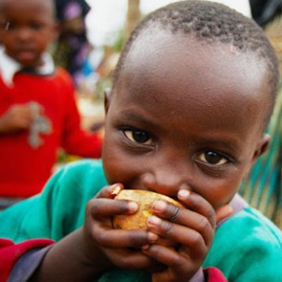
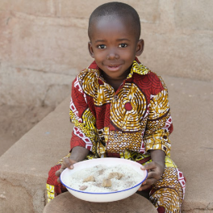
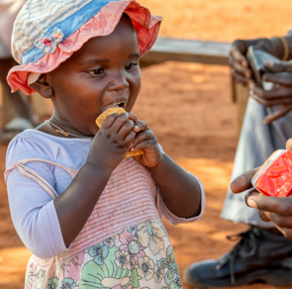
An international project
You are about to take part in a research project that is helping to address a problem affecting
162 million children
in the world today.
The project is based in three countries, India, Indonesia and Senegal
with research also taking place in the
United Kingdom (UK).
SENEGAL
INDIA
INDONESIA

Slide 3
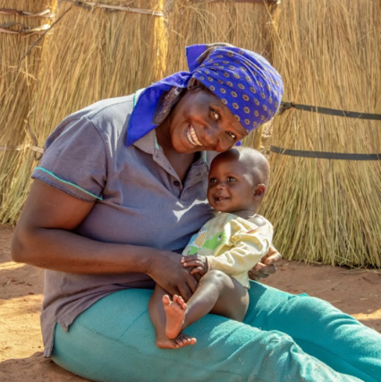
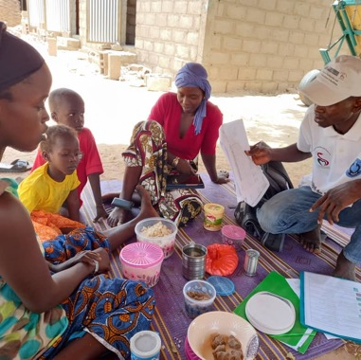
What is the problem?
Soon, your teacher will split you up into groups representing the four countries taking part in the project.
Each of you will be given a card with your ‘role’ on it. Spend a moment looking at the photographs on your table, then read about who you are
and your role in the project.
At least two people per group are researchers. If you are one of them, take notes on what you hear from the rest of the group. Now take it in turns to share the information on your cards.
!
Listen carefully to what
everyone has to say.

Slide 4
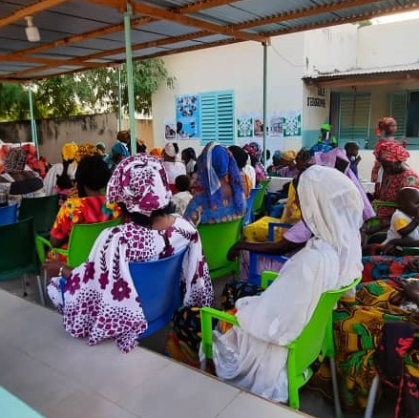
What did you find out?
Now that you have found out about the problem in your own country group, it is time to discover what information the researchers gathered from each country.
Were there
any problems that were the same in each country, or most of the countries? if so, what
were they?
Why do you think some scientists and research projects choose to work across different countries? What might be the benefits
of this?

Slide 5
What is child stunting?
By now, you will have guessed that we are
looking into a problem that affects children’s
development, in particular ‘child stunting’.
Stunting harms children in two ways. It can:
1
2
Stop them from growing as tall as other children of the same age (physical development).
Make it more difficult for them to learn new skills and reach the milestones typical for their age e.g. speaking (cognitive development).
This can often affect children’s chances of doing well in school and gaining work in the future.

Slide 6
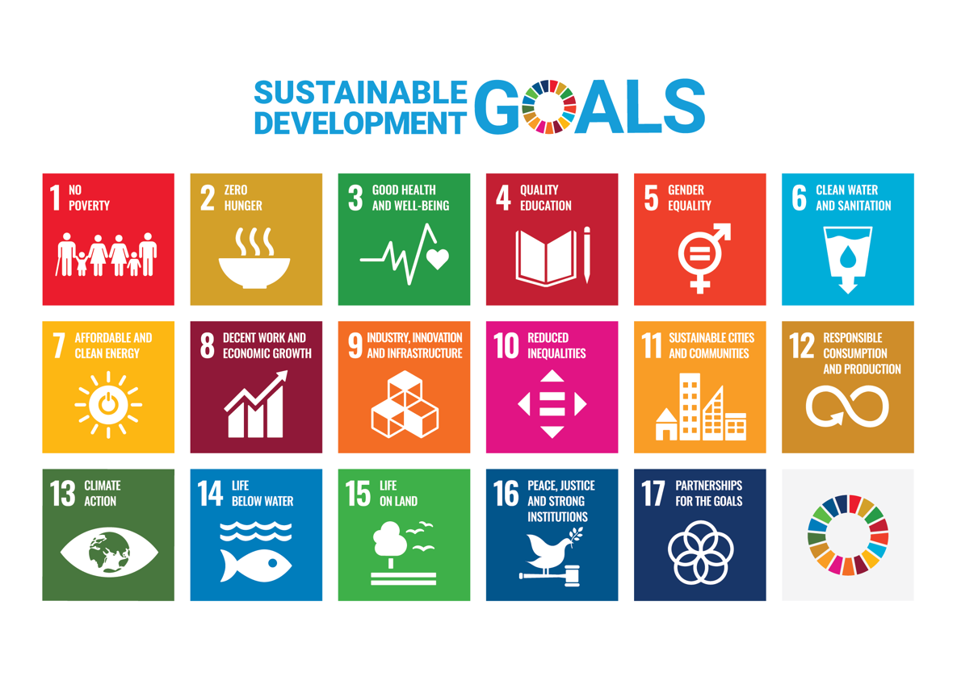
The Sustainable Development Goals
Child stunting causes concern for many people in the world today.
Thankfully, many organisations and projects are working to address the problem.
One of those organisations is the United Nations. In 2015 they called for global action ‘to end poverty, protect the planet, and ensure that by 2030 all people enjoy peace and prosperity.’
Seventeen Sustainable Development Goals – or Global Goals, for short – were developed, with targets to be met by 2030.
!
Which goal or goals do you think should be tackled to reduce child stunting?

Slide 7
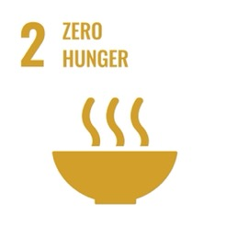
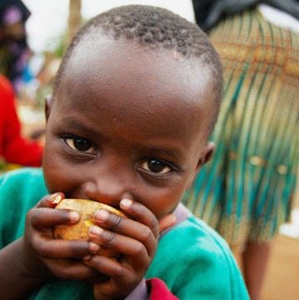
Global goal 2 – Zero Hunger
Global Goal 2 - Zero Hunger
has an overall aim to end hunger, achieve food security and improved nutrition by 2030.
Within the goal, target 2.2 aims to reduce the number of stunted children in the world who are under 5 by 40% by 2025.
That is not very far away!
So, what can we do
reach this goal?

Slide 8
Action Against Stunting – it’s all about the research!
At the first international meeting, the researchers all agreed it was important to really understand the main causes of stunting in each country. They identified many areas to research and methods to collect data.
What methods do you think the researchers planned to use to collect data to answer the questions below?
1 How can we
monitor the growth of babies and children?
Method
By collecting records of babies’ and children’s weight and height from mothers and health workers.
2 How can we
find out about different illnesses and diseases experienced by babies and children?
Method
By running household health surveys for pregnant women and parents to complete.
By collecting wee, poo, breast milk and blood samples for analysis.
3 How can we
know what families including pregnant women and children are eating?
Method
By asking parents to keep a food diary.
By interviewing parents involved with preparing meals.
4 How can we
find out about the foods available to families at different times of the year?
Method
By tracking foods from ‘farm to plate’.
By interviewing farmers.

Slide 9
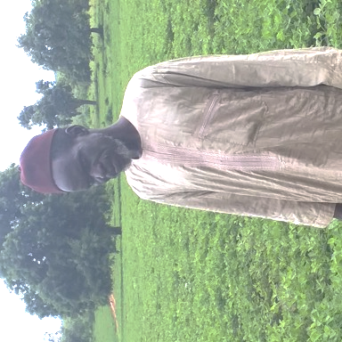
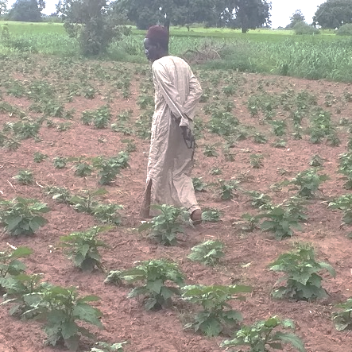
Research findings - An interview with a farmer from Senegal
Malick Dia is farmer who lives in the
Kaffrine region of Senegal in West Africa.
He and his family live on a fifteen-acre farm growing a range of fruits and vegetables.
He is one of many farmers who have been interviewed by an Action Against Stunting researcher.
The researchers record answers to questions about the crops that farmers are growing and any problems they are facing to feed their families and to supply food to sell at markets.
Find out more about Malik in a case study given to you by your teacher.

Slide 10
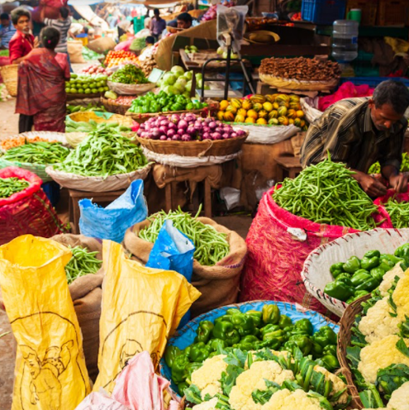
Research findings – from women and children in India
Dr Suneetha Kadiyala, a researcher with
Action Against Stunting from the
London School of Hygiene and Tropical Medicine,
claims that on average people in India only eat
200g of fruit and vegetables per day, yet
‘Fruit and vegetables are rich in key nutrients, and eating the recommended daily amount is important during pregnancy and throughout life to prevent many illnesses and disease.’
The World Health Organisation (WHO)
recommends that people eat 400g
of fruit and vegetables per day.
Some of the
research findings
from studies into
the diets of pregnant women and children
in parts of India
are concerning
some of the
researchers.

Slide 11
True or false?
What do we know from the research so far?
Decide if you think the statements are TRUE or FALSE!
Many pregnant women and children don’t eat the recommended daily intake of fruit and vegetables.
Farmers sometimes let their produce go to waste as paying for transport to market is too expensive.
Fruit and vegetables contain important nutrients that help prevent illness and disease.
In some areas fruit and vegetables are in scarce supply, so families go without.
Fruit and vegetables perish and rot more quickly when left in cool conditions.
Bruised or damaged fruit and vegetables are less likely to reach a good profit for farmers at market.
Many farmers send their produce to market without packaging it or wrapping it in newspaper.
TRUE
TRUE
TRUE
TRUE
FALSE
TRUE
TRUE

Slide 12
The Road to Zero Hunger – a STEM challenge for you!
Are you up for the challenge?
Work as a team to use your knowledge from the project and your STEM skills to design and make an attachment or trailer for a bicycle to help a farmer transport at least two different types of fruits and vegetables to a local market, in a way that makes sure they don’t get bruised.
An extra challenge
You might also want to make something that keeps the fruits and vegetables cool, so they arrive at the market fresh and haven’t started to decay.
So, what if we
could find a way to
make it worthwhile for farmers to get their produce to local markets and to families who
are not eating the recommended daily amount of fruit
and vegetables?

Slide 13
Your tasks
Describe the problem
In your own words, describe the problem you are trying to solve.
Teamwork
Decide who is going to do which tasks, so that you spread the work between you.
Research
Write up any research you did to help you to understand the problem and/or to develop your ideas.
Design ideas
Sketch and/or use modelling materials to develop your ideas for your bicycle attachment and/or packaging ideas.
Final design and model
Sketch out the idea that you think will solve the problem and make a model or full prototype of your idea.
Test and evaluate
Test how well you transported the two different fruits and/or vegetables to ‘market’. If you repeated the model, what would you do differently?
Final thought
What have you learnt from doing this project overall?
At the end of the challenge,
you will be asked to present
your work.
To help you work through your challenge, we suggest that you look at the tasks that need to be completed and decide who is going to do what!
Your teacher will give you a set of sheets to capture your work.

Slide 14
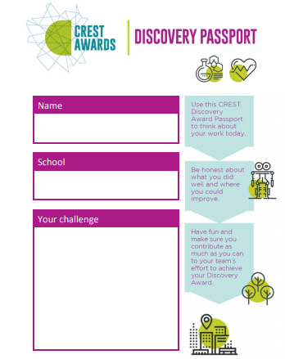
CREST Discovery Award
If you are working towards a CREST Discovery Award with this project, look at the Discovery Passport and don’t forget to fill it in throughout your challenge.
You will be asked to reflect on:
Your role
What was your role in the challenge?
Teamwork
How well did you work in
your team?
Problem solving
How did you go about solving the problem you were set?
Research
What research did you do to help you solve the problem?
Knowledge
What knowledge have you gained? What do you know now that you didn’t know before?
Skills
What skills have you gained and used?
Communication
How well did you listen to others in your team? How well did you present your work?

Slide 15
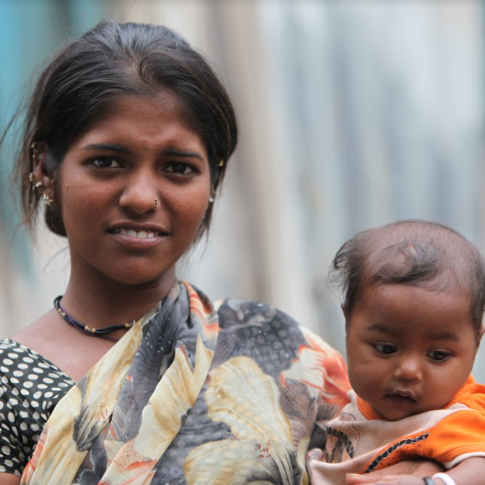
What next?
If you have enjoyed working on this project, then please keep updated with Action Against Stunting
actionagainststuntingday.org
actionstunting
actionstunting
We will be producing more education resources over the next few years, so please keep an eye out for them.
Child stunting is preventable …no child should have to
grow up with the lifelong consequences.

