Slide 1
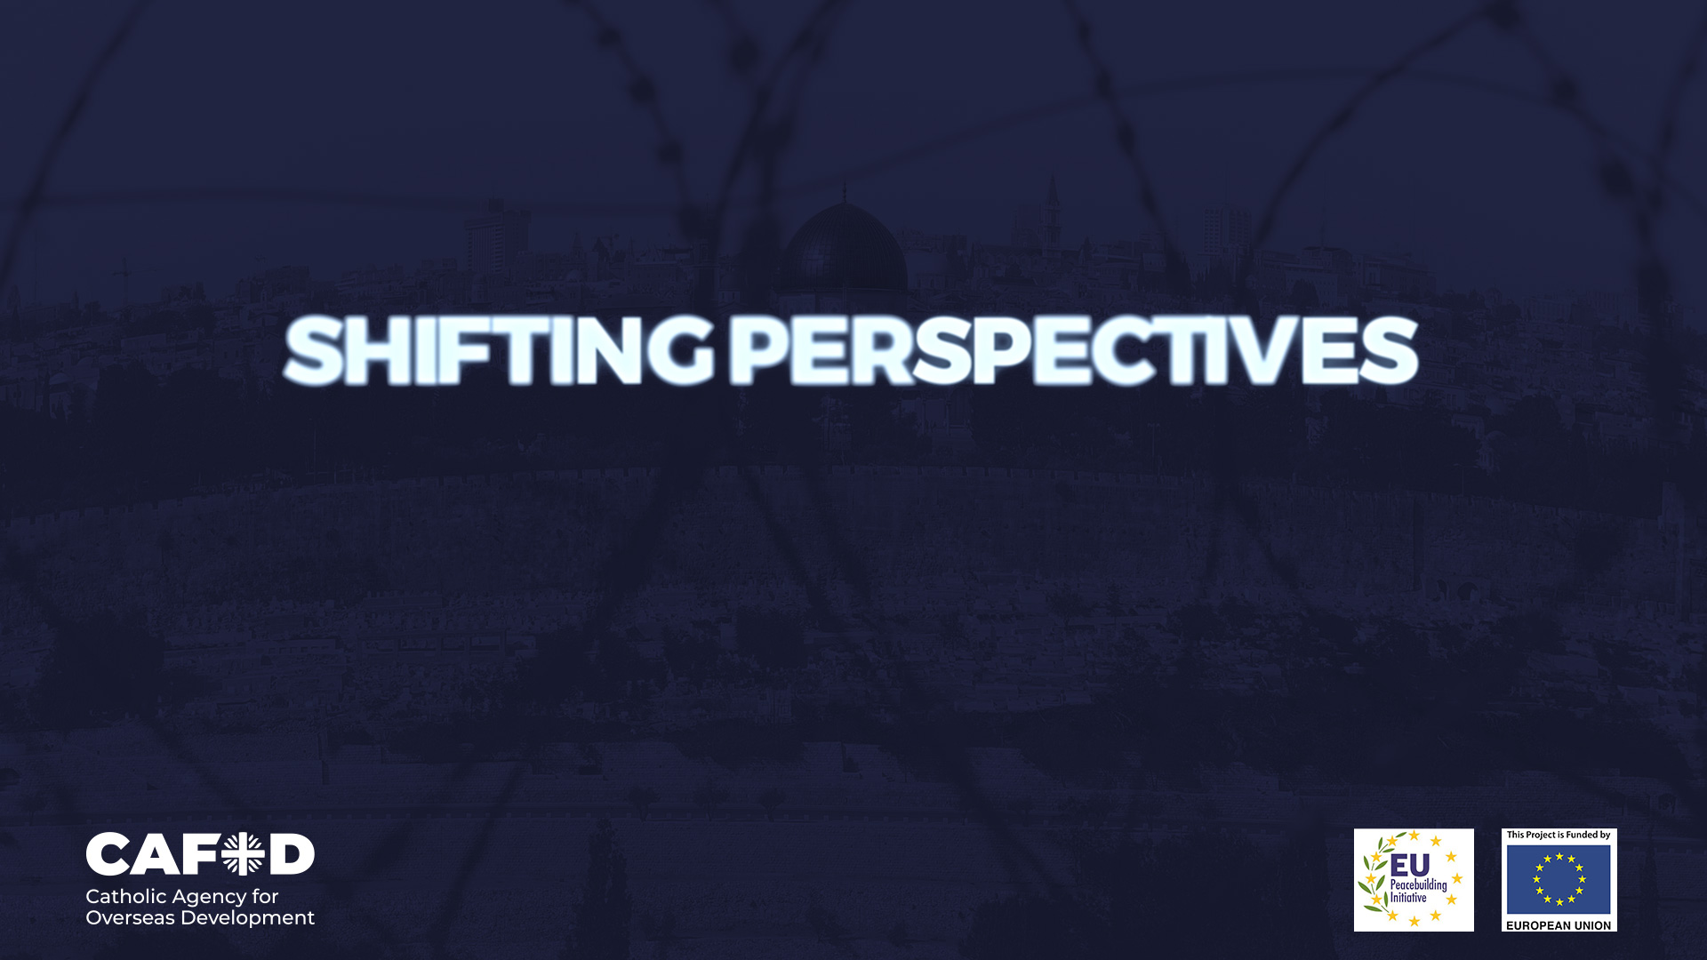
The Holy Land

Slide 2
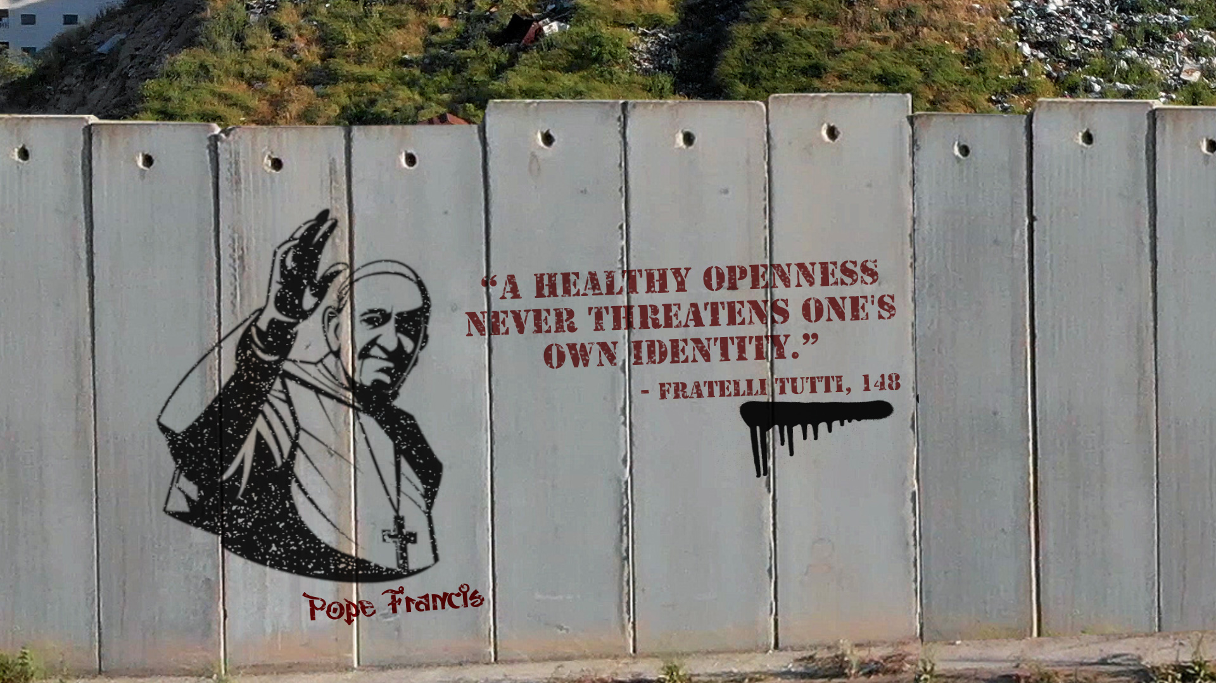

Slide 3
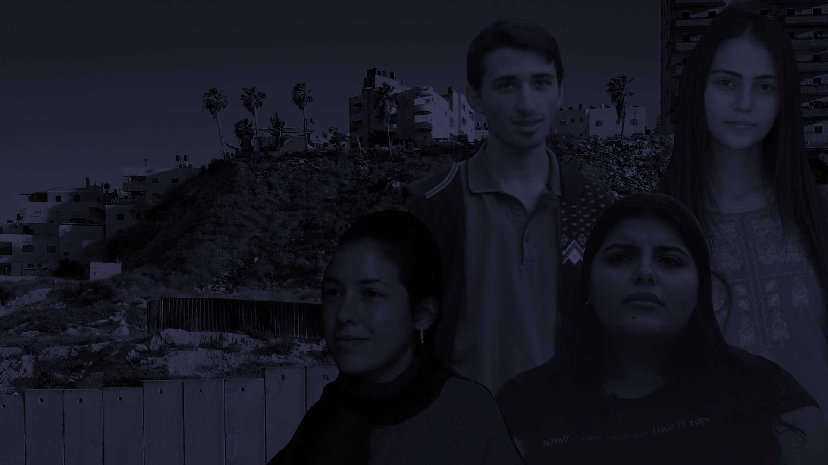
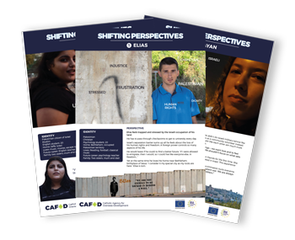
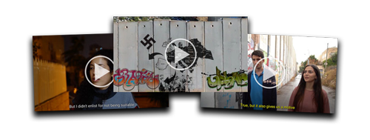
INTRODUCTION
Today we explore the perspectives of four young people in the Holy Land.
Our resource comes from CAFOD, who work with young people in the region to promote peace and dialogue. They encourage young people from different backgrounds to see each other’s points of view.
Sources for today’s lesson:
Historical background to the Israeli-Palestinian conflict. ​
Witness testimony of four young people. ​
Catholic Social Teaching from Pope Francis’s encyclical Fratelli Tutti.

Slide 4
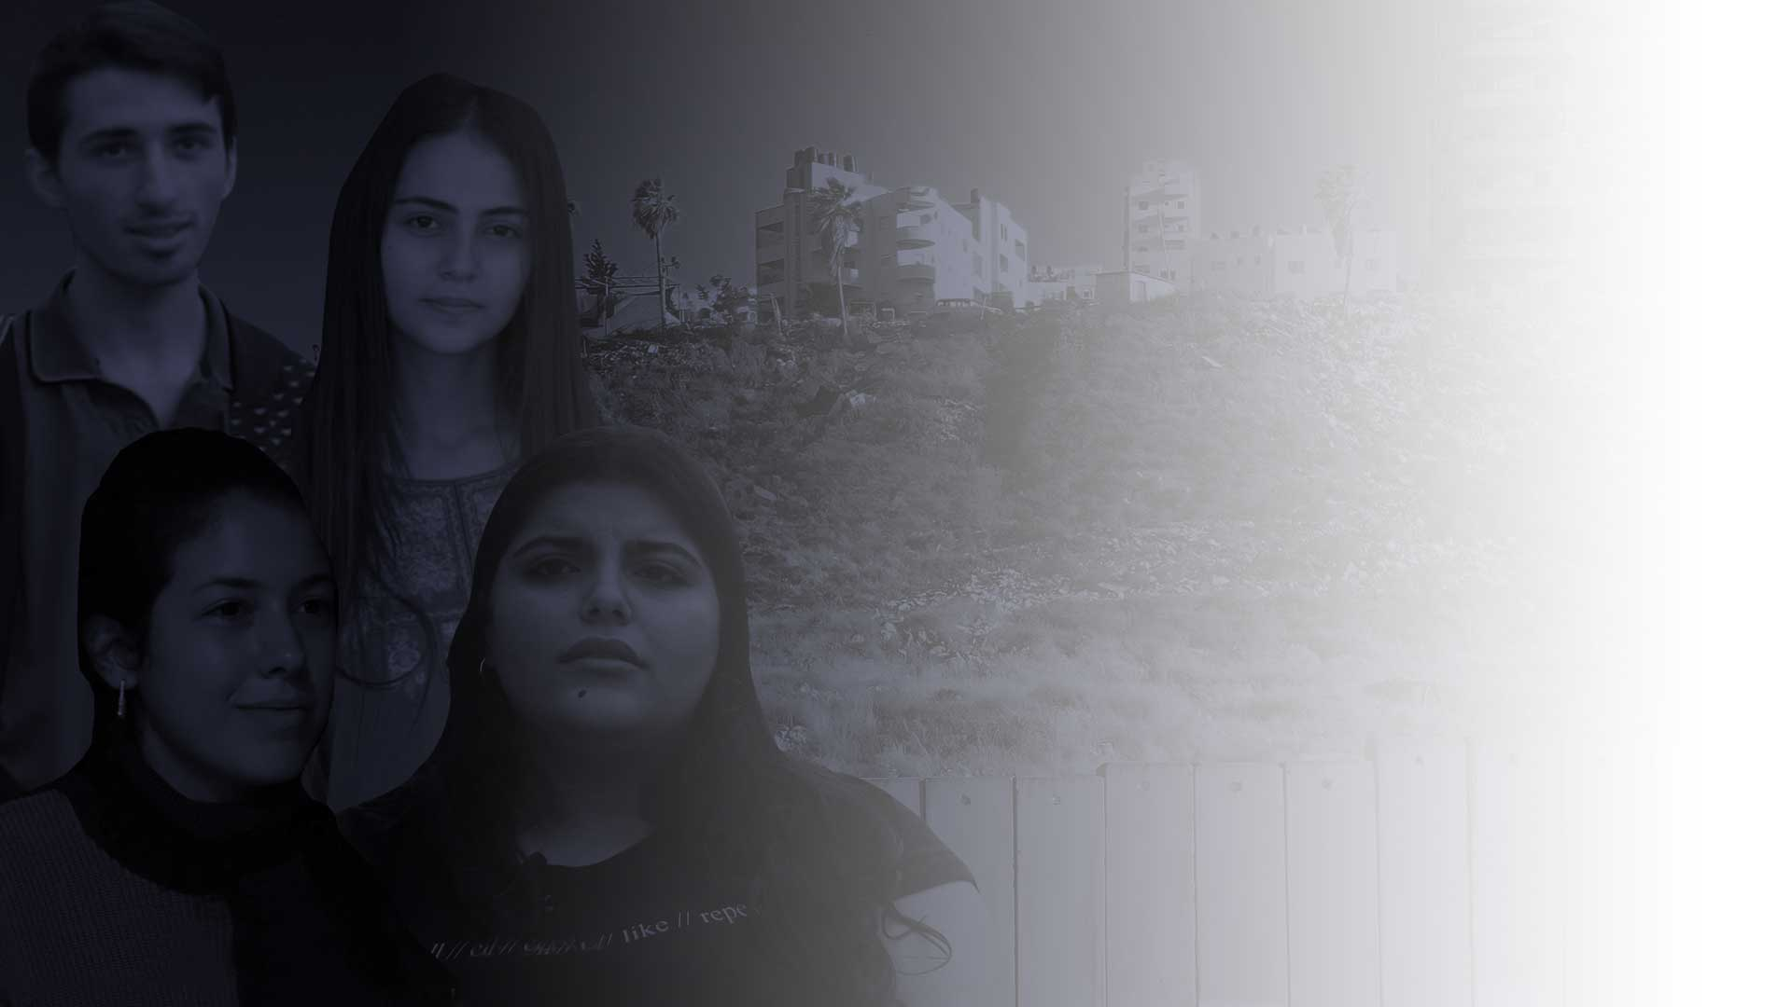
FOUR YOUNG PEOPLE
FOUR DIFFERENT PERSPECTIVES
Decades of conflict in the Holy Land have brought fear and hostility on all sides.
Today’s lesson will look at these questions:
How are young Palestinians and Israelis finding their way through the conflict?
What does the conflict mean for their identity and their chances of a full life?
How could a shift in their perspectives
bring hope?
Let’s explore

Slide 5
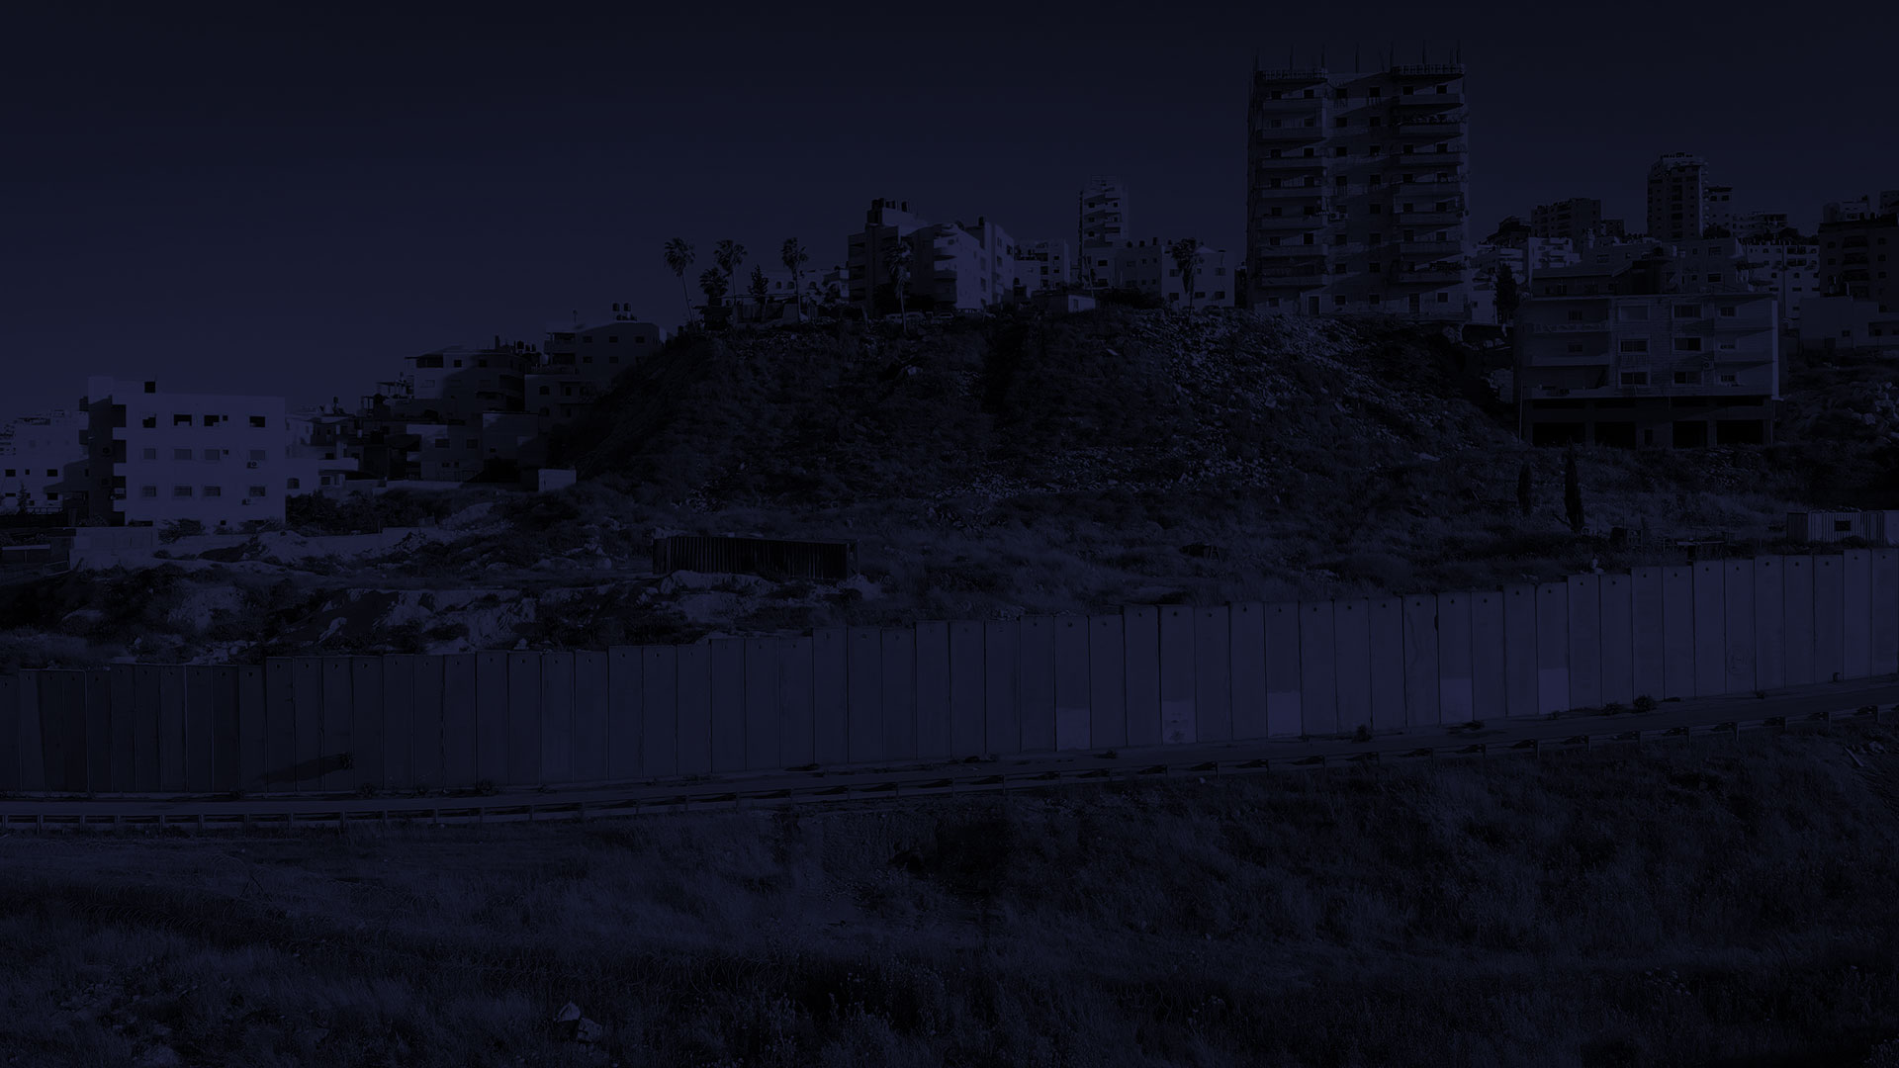

GROUND RULES
The conflict in the Holy Land is a highly sensitive topic.
Racism – against Palestinians, anti-Semitism and Islamophobia – is present in the Holy Land as it is in the UK.
Misinformation – many opposing voices put out information based on their own interpretation of the facts.
In today’s session we will discuss calmly, seeing things from different perspectives.
We acknowledge we may not be aware of the full story.
We will not use racist language or stereotyping.
We will challenge each other’s views – but without aggression.

Slide 6
Q: Can talking to people unlike yourself enrich your own sense of identity? What happens if we just stay in groups of similar people?

Slide 7
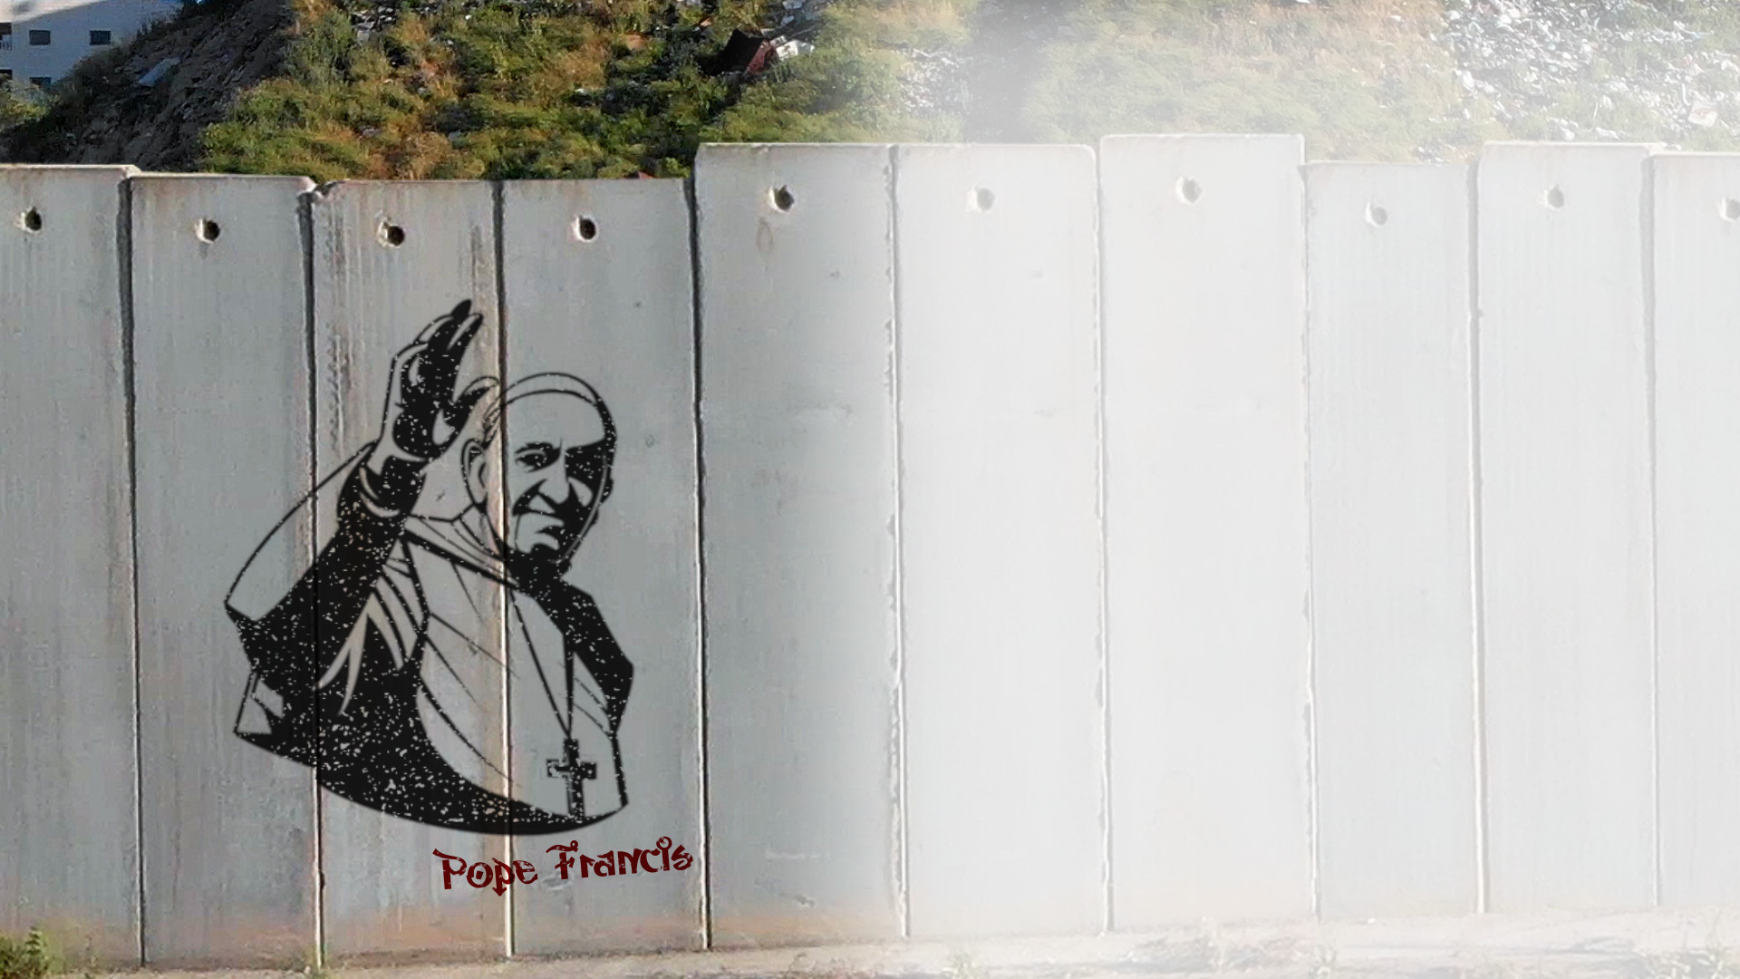
Pope Francis says the world grows
and becomes more beautiful
as free and open cultures meet
and gradually influence each other.
Think about examples in your own life.

Slide 8
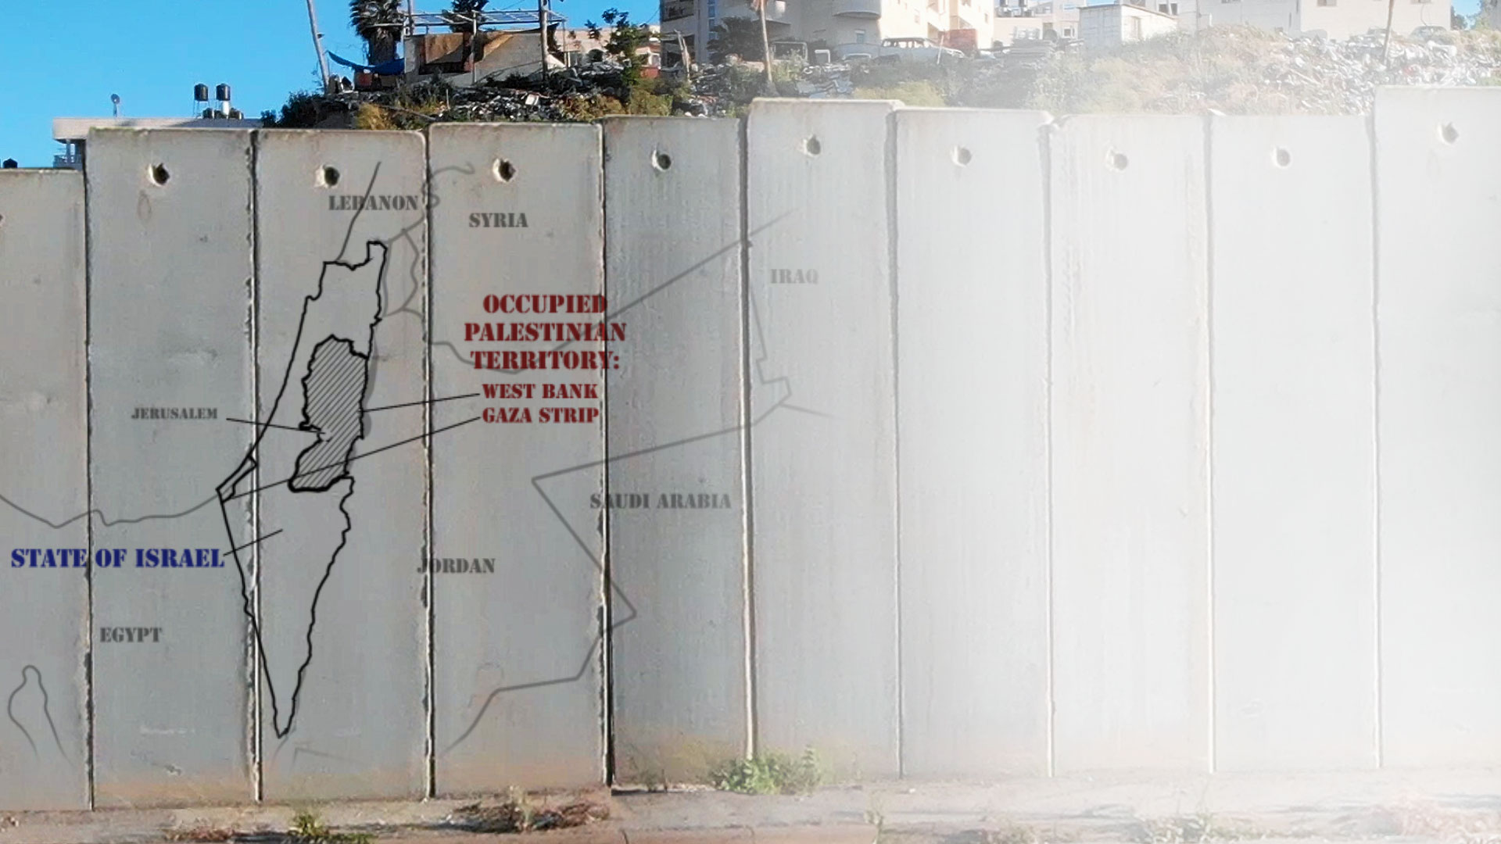
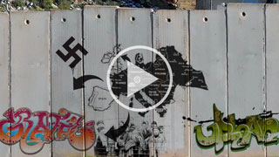
PREPARATION FOR VIDEO 1
FIGHTING ON HOLY GROUND
Look out for how to answer these questions:
What does the video tell us about the main sources of conflict in the Holy Land?
How do you think Palestinians felt about the creation of the State of Israel? How about the Jewish people?
Watch Video 1 – The Holy Land: A brief history

Slide 9
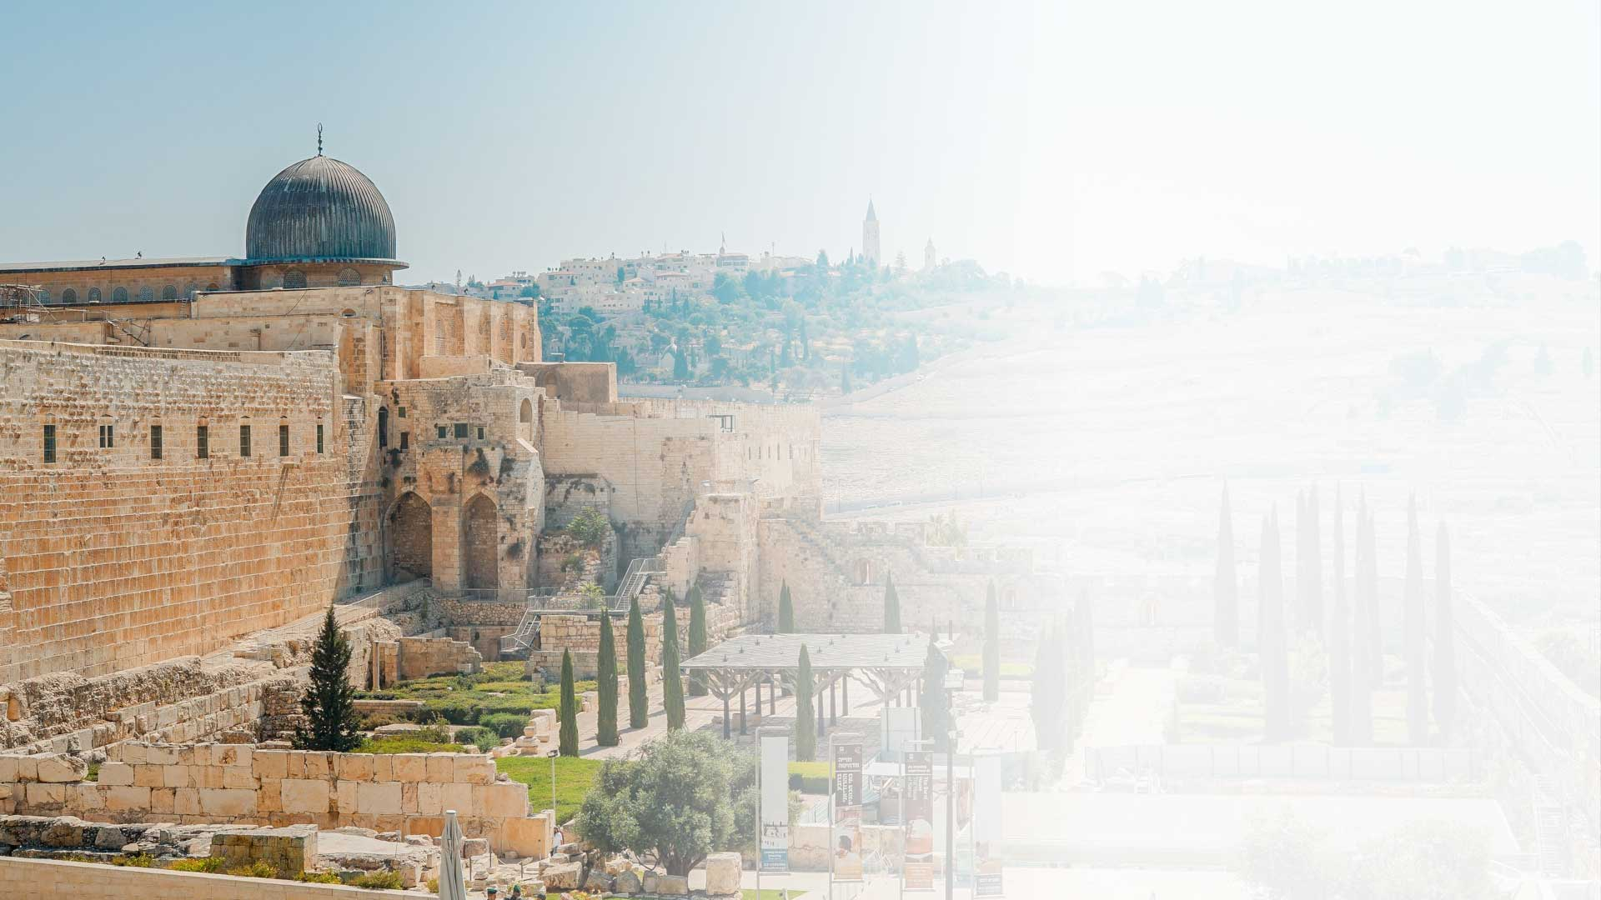
BACKGROUND TO VIDEO 1
JERUSALEM, CITY OF FAITH
What do you know about the religious importance of Jerusalem for Jews, Muslims and Christians?
For Jews: the site of the First Temple
For Christians: Jesus died and rose here
For Muslims: the Prophet Mohammed ascended to heaven from here

Slide 10
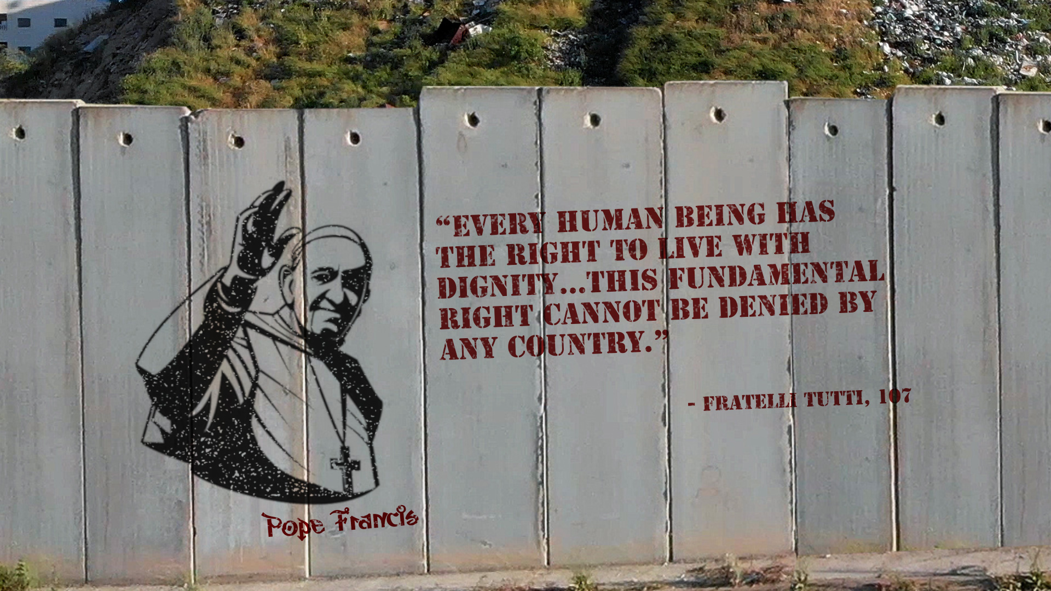
Q: Give an example of how this right
is denied to people living in the Holy Land today.

Slide 11
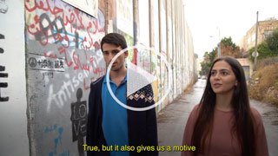
PREPARATION FOR VIDEO 2
Split into two groups:
One group will be Elias and explain why he wants to leave.
One group will be Amal and explain why she wants to stay.
Watch Video 2 – Elias and Amal: in the occupied Palestinian territory

Slide 12
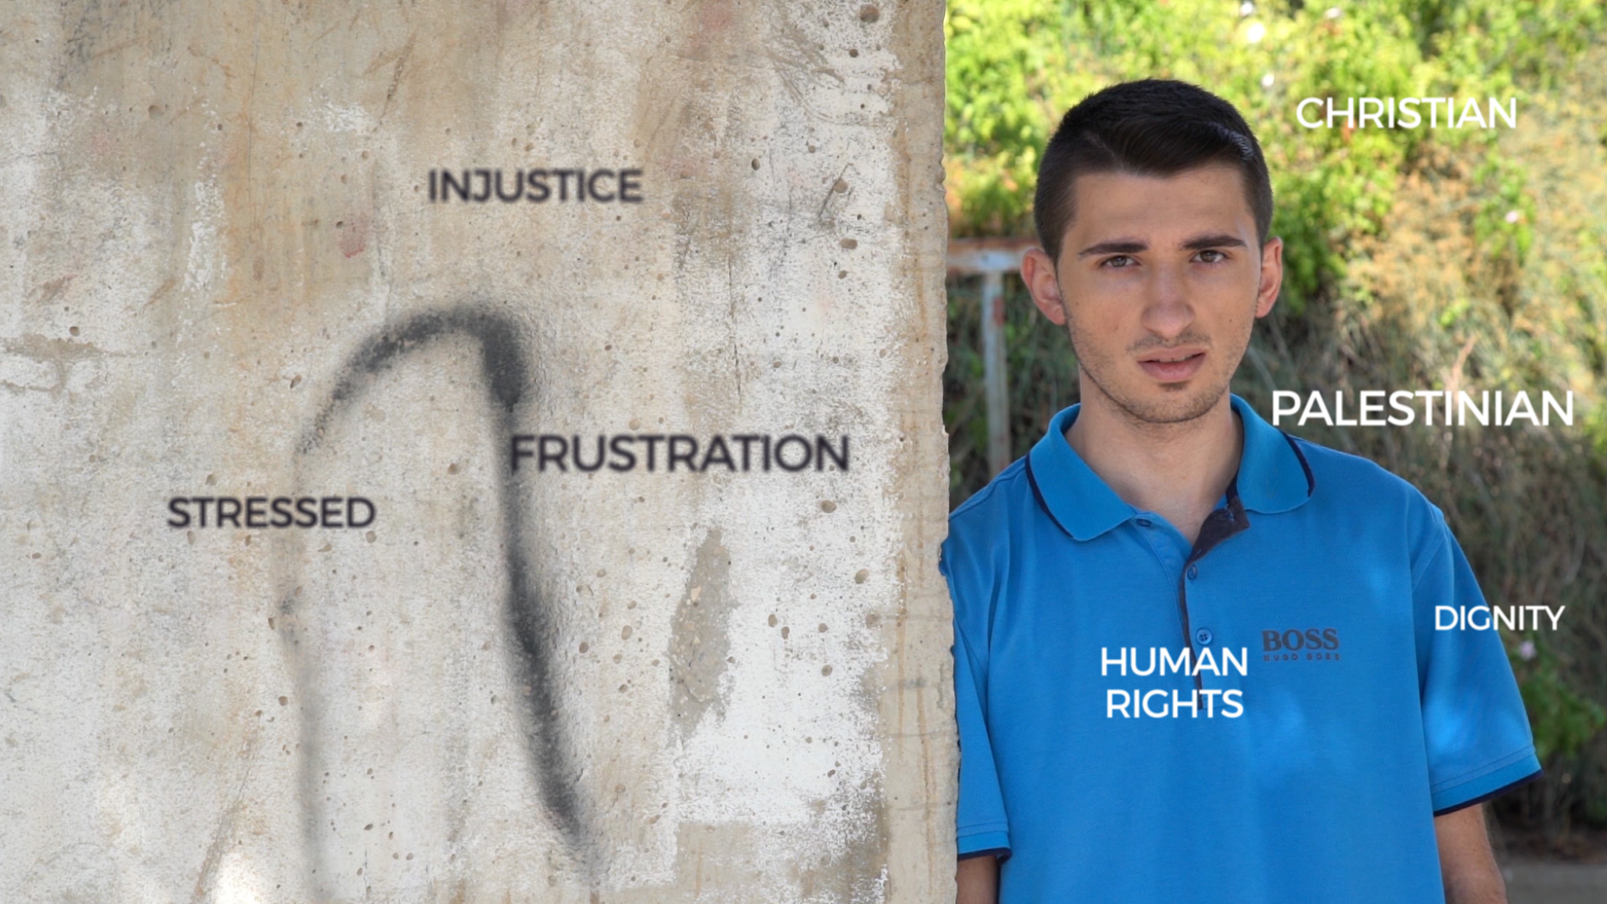
ELIAS
CHRISTIAN
PALESTINIAN
FRUSTRATION
HUMAN RIGHTS
INJUSTICE
DIGNITY

Slide 13
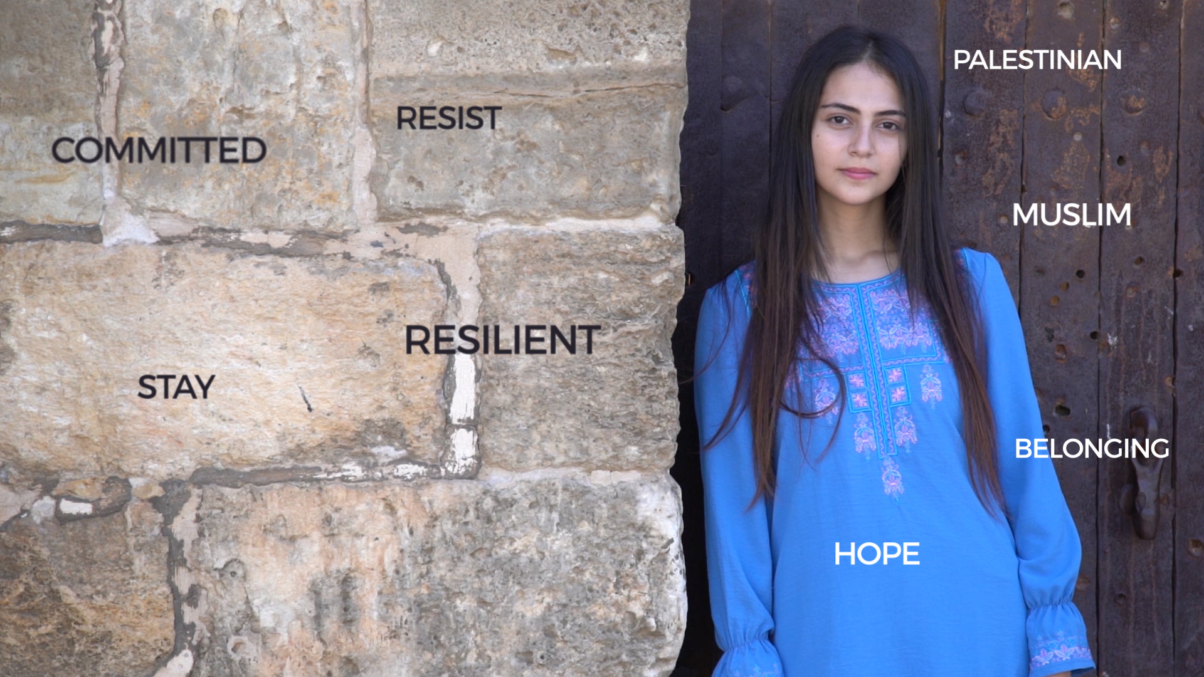
AMAL

Slide 14
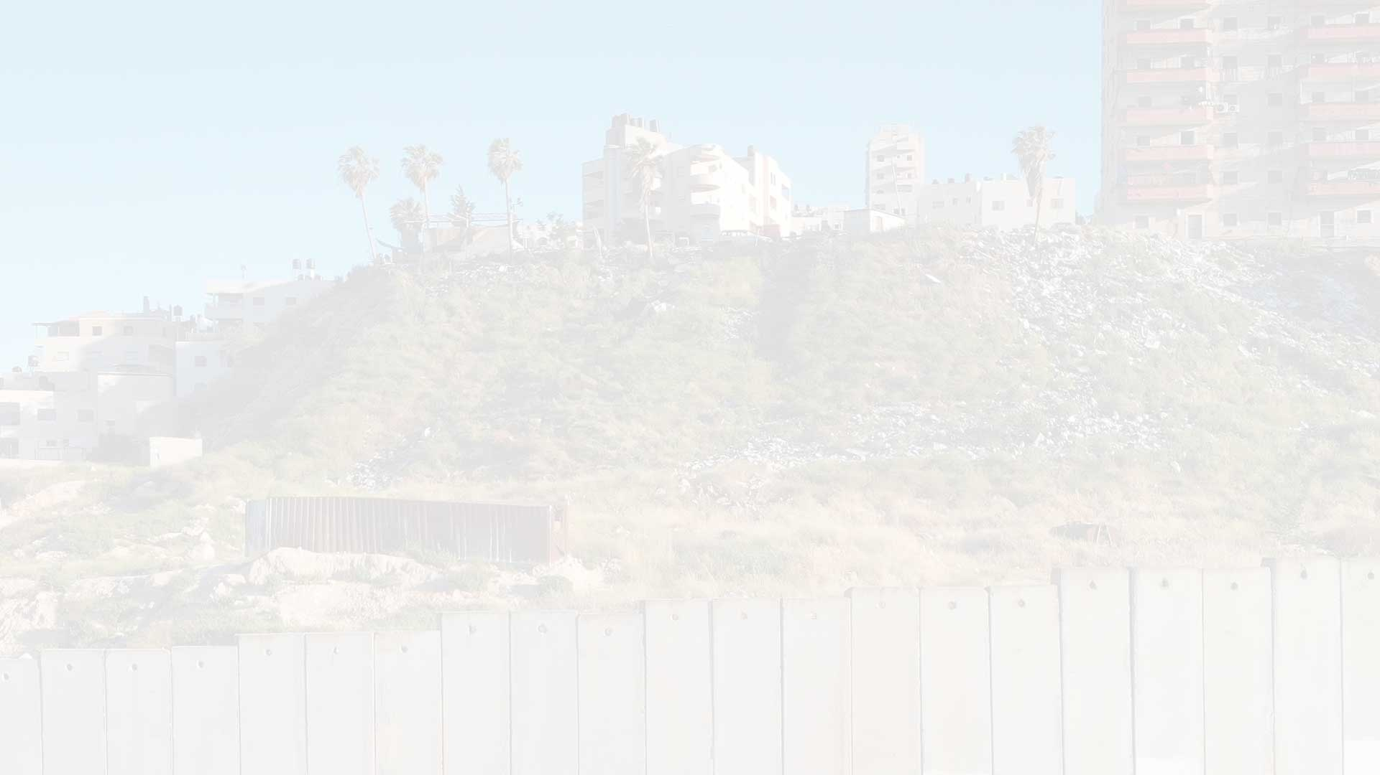
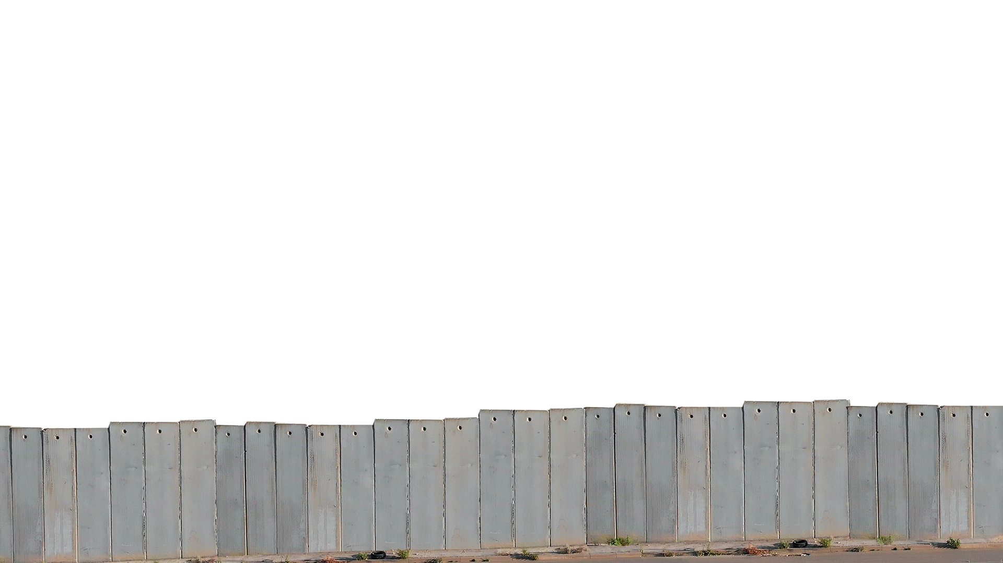
BACKGROUND TO VIDEO 2
THE SEPARATION BARRIER
Israelis often call it a “security barrier”: for them it means protection from possible attacks.
Palestinians often call it an “apartheid wall”: for them it means being trapped, and in many cases separated from their own communities.
11,000* Palestinians are separated by the barrier from the rest of the West Bank.
442 miles long
*Estimated figure: UN OCHA, Aug 2020

Slide 15
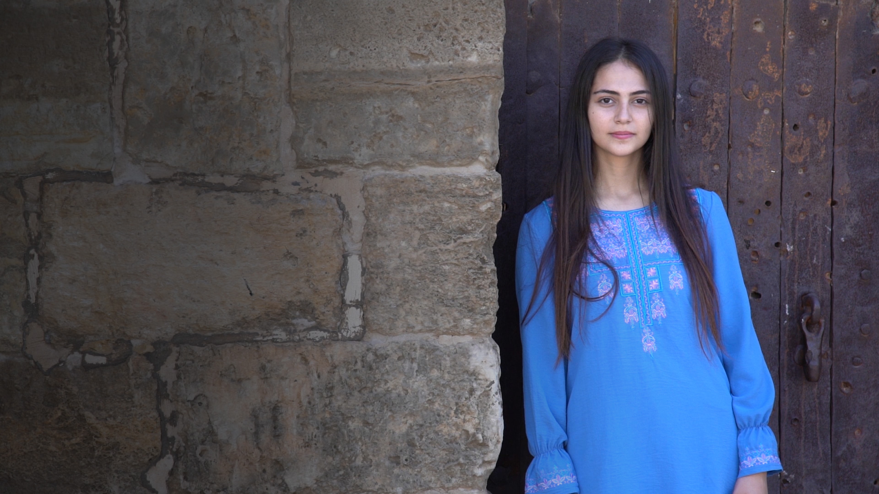
AMAL’S QUESTIONS FOR YOU
Where do I belong?
What does home mean to me?
What do I do if I see injustice around me?
Do I get involved?

Slide 16
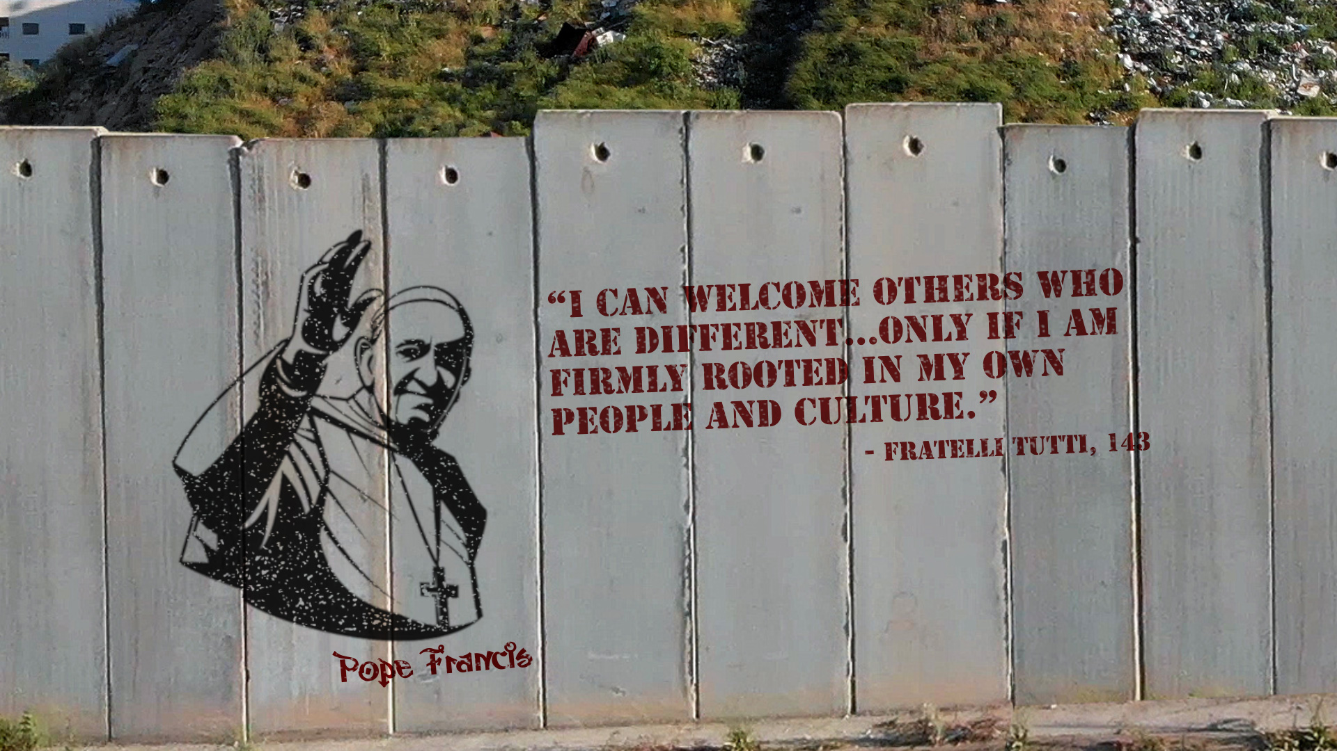
Q: How can we value our own culture while also caring about the rest of our global family?

Slide 17
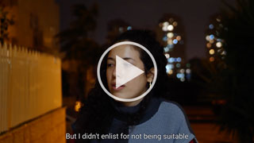
PREPARATION FOR VIDEO 3
Split into two groups:
One group will be Maayan.
One group will be Hiba.
You will pair with someone from the other group to discuss what might affect the two girls’ view of each other.
Watch Video 3 – Maayan and Hiba: the State of Israel

Slide 18
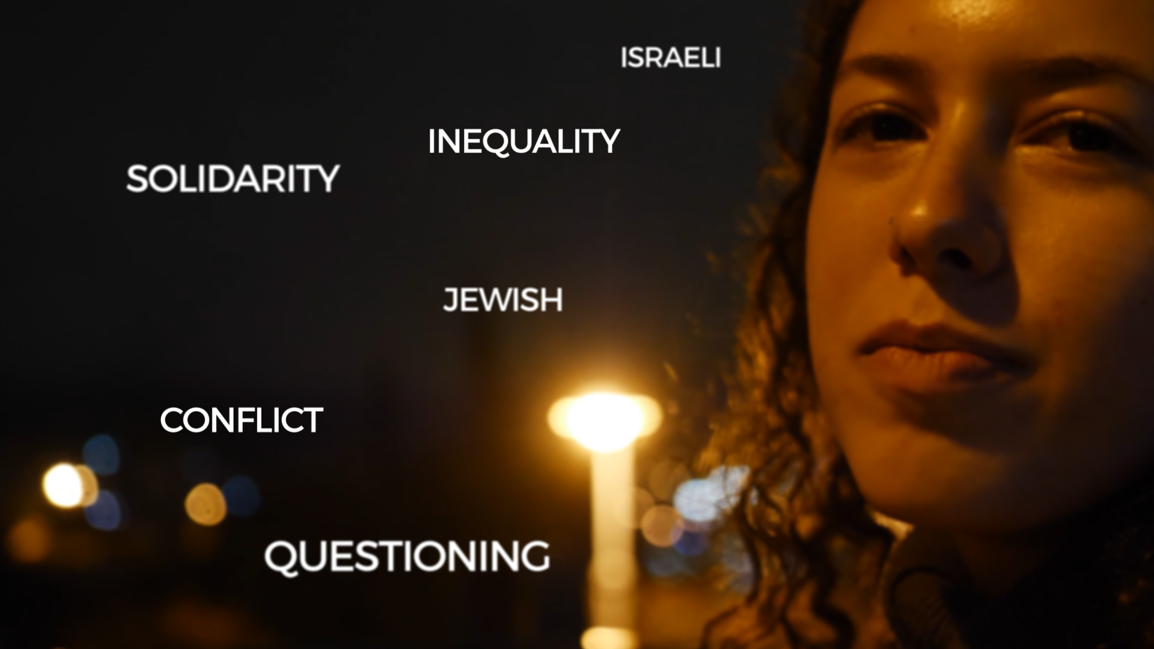
MAAYAN

Slide 19
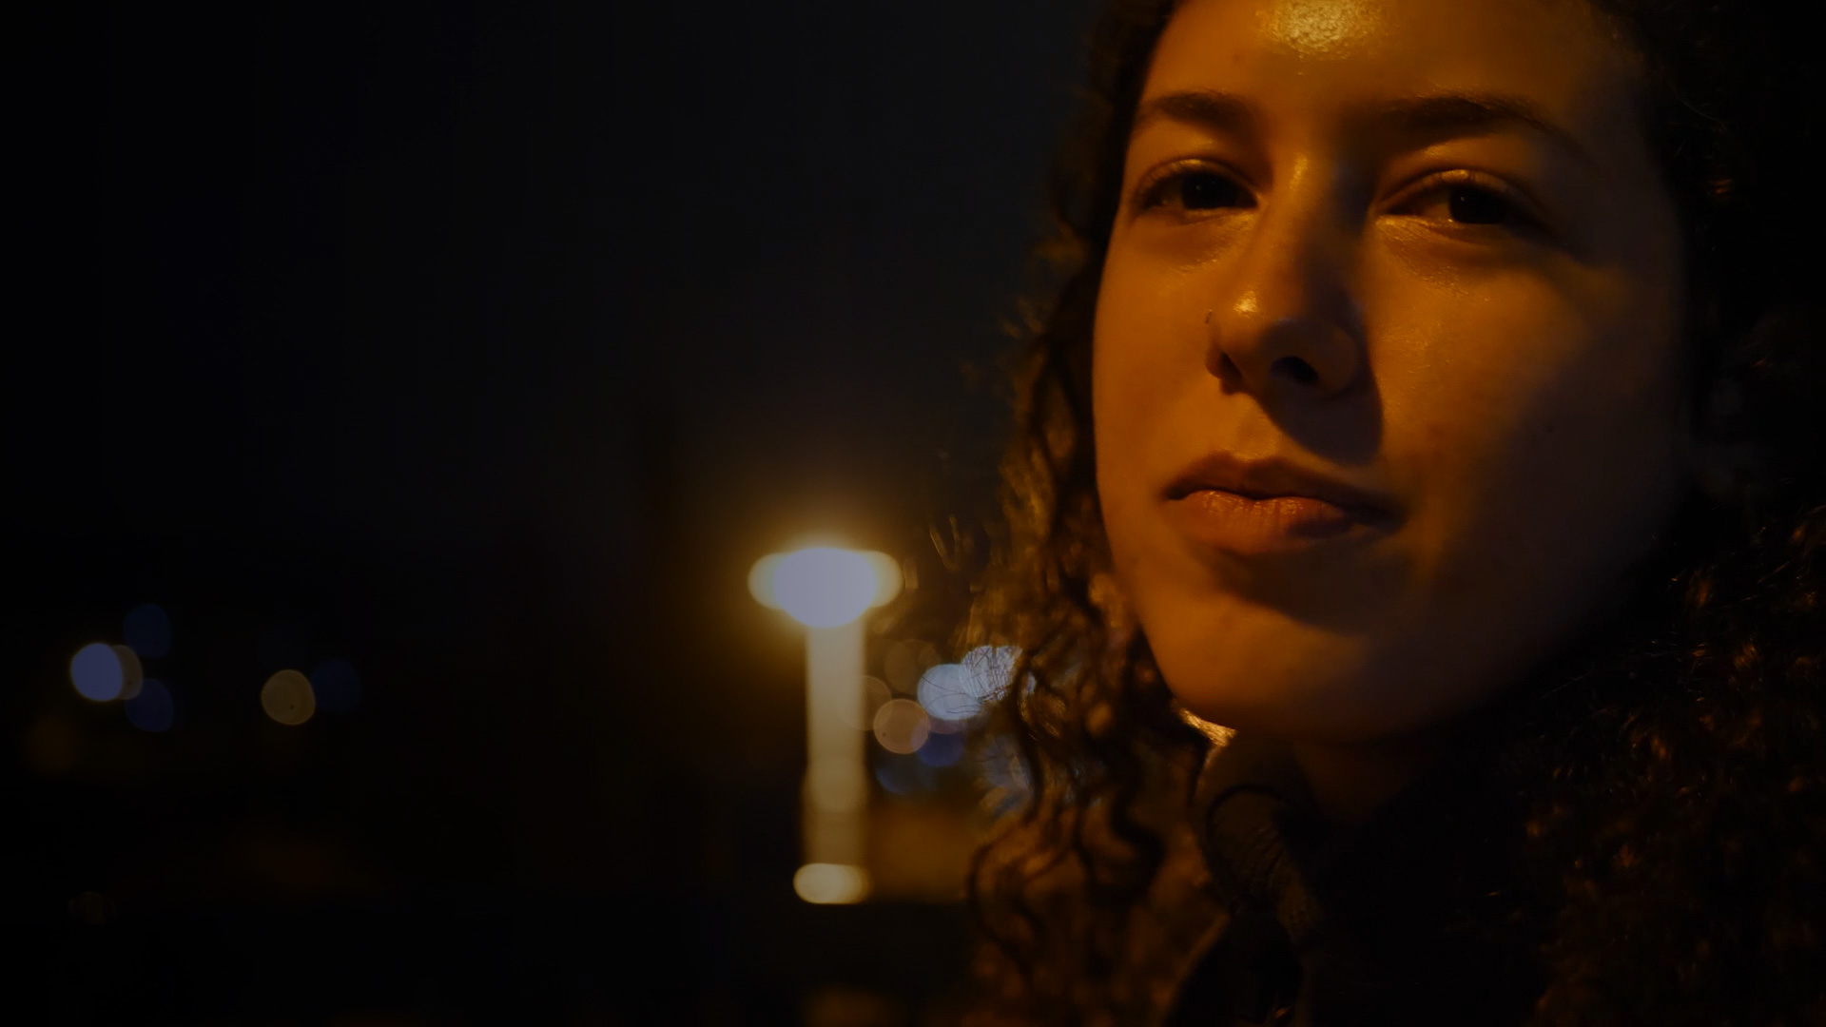
MAAYAN: QUESTIONS
How did Maayan change when she met Palestinian citizens of Israel for the first time?
If UK school leavers had to do military service, would you join up or do volunteering instead? Would your choice change if our country were threatened by attack?

Slide 20
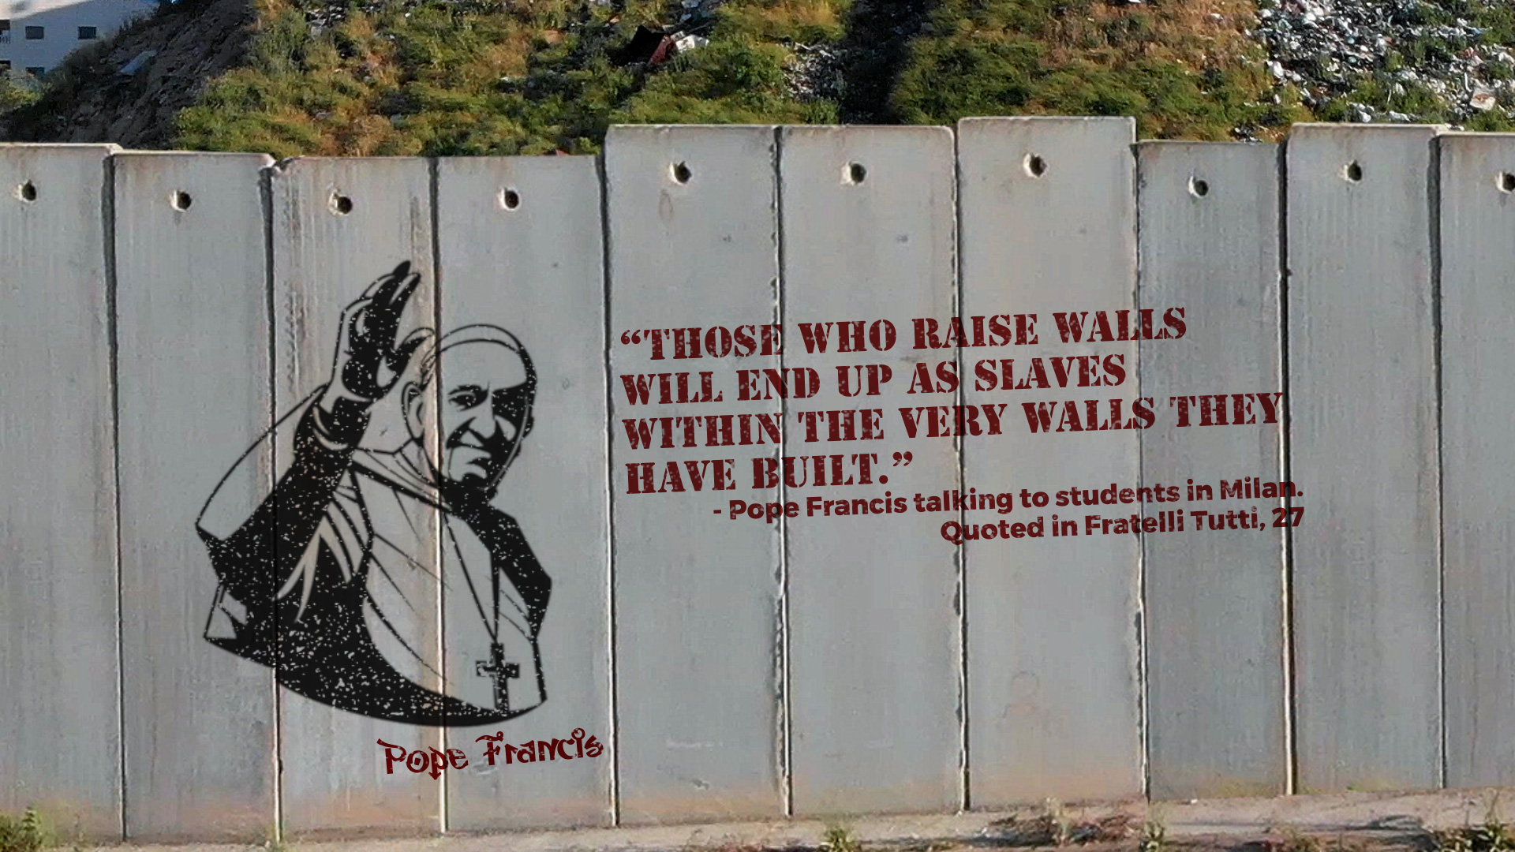
Q: Do you think this is true?
Give your reasons.

Slide 21
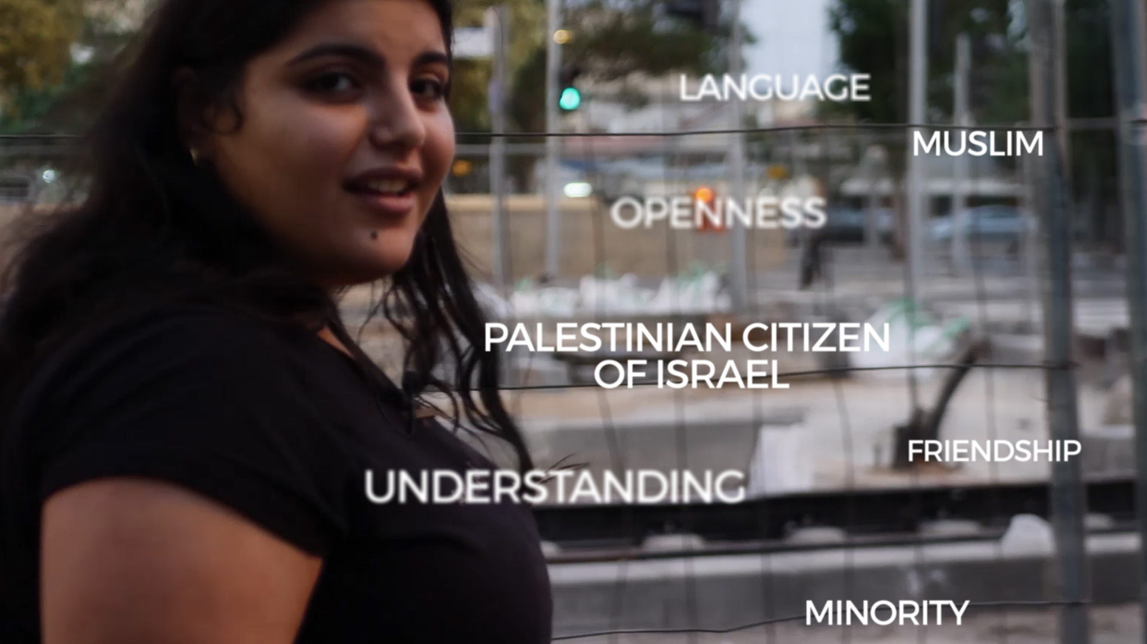
HIBA

Slide 22
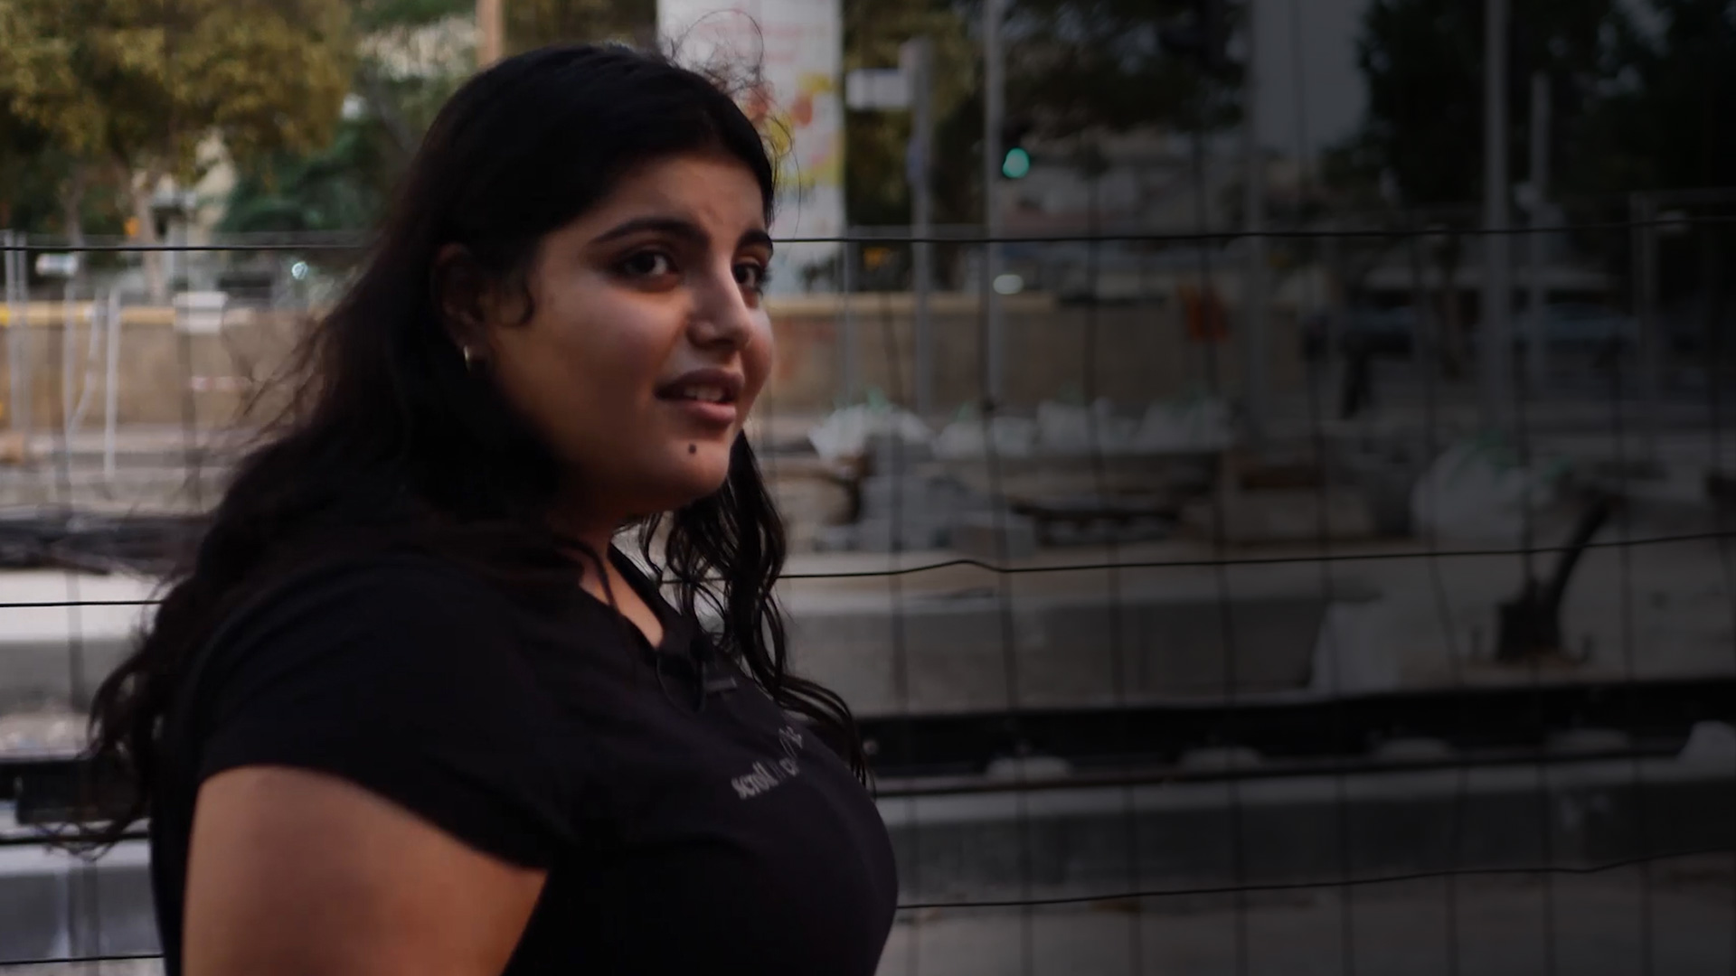
HIBA: QUESTIONS
Hiba is Palestinian by nationality, and Israeli by citizenship. Discuss possible problems of identity this raises.
Hiba speaks the language of both communities – but is it hard to be a bridge between two cultures?
How can we be a bridge between different cultures and communities?

Slide 23
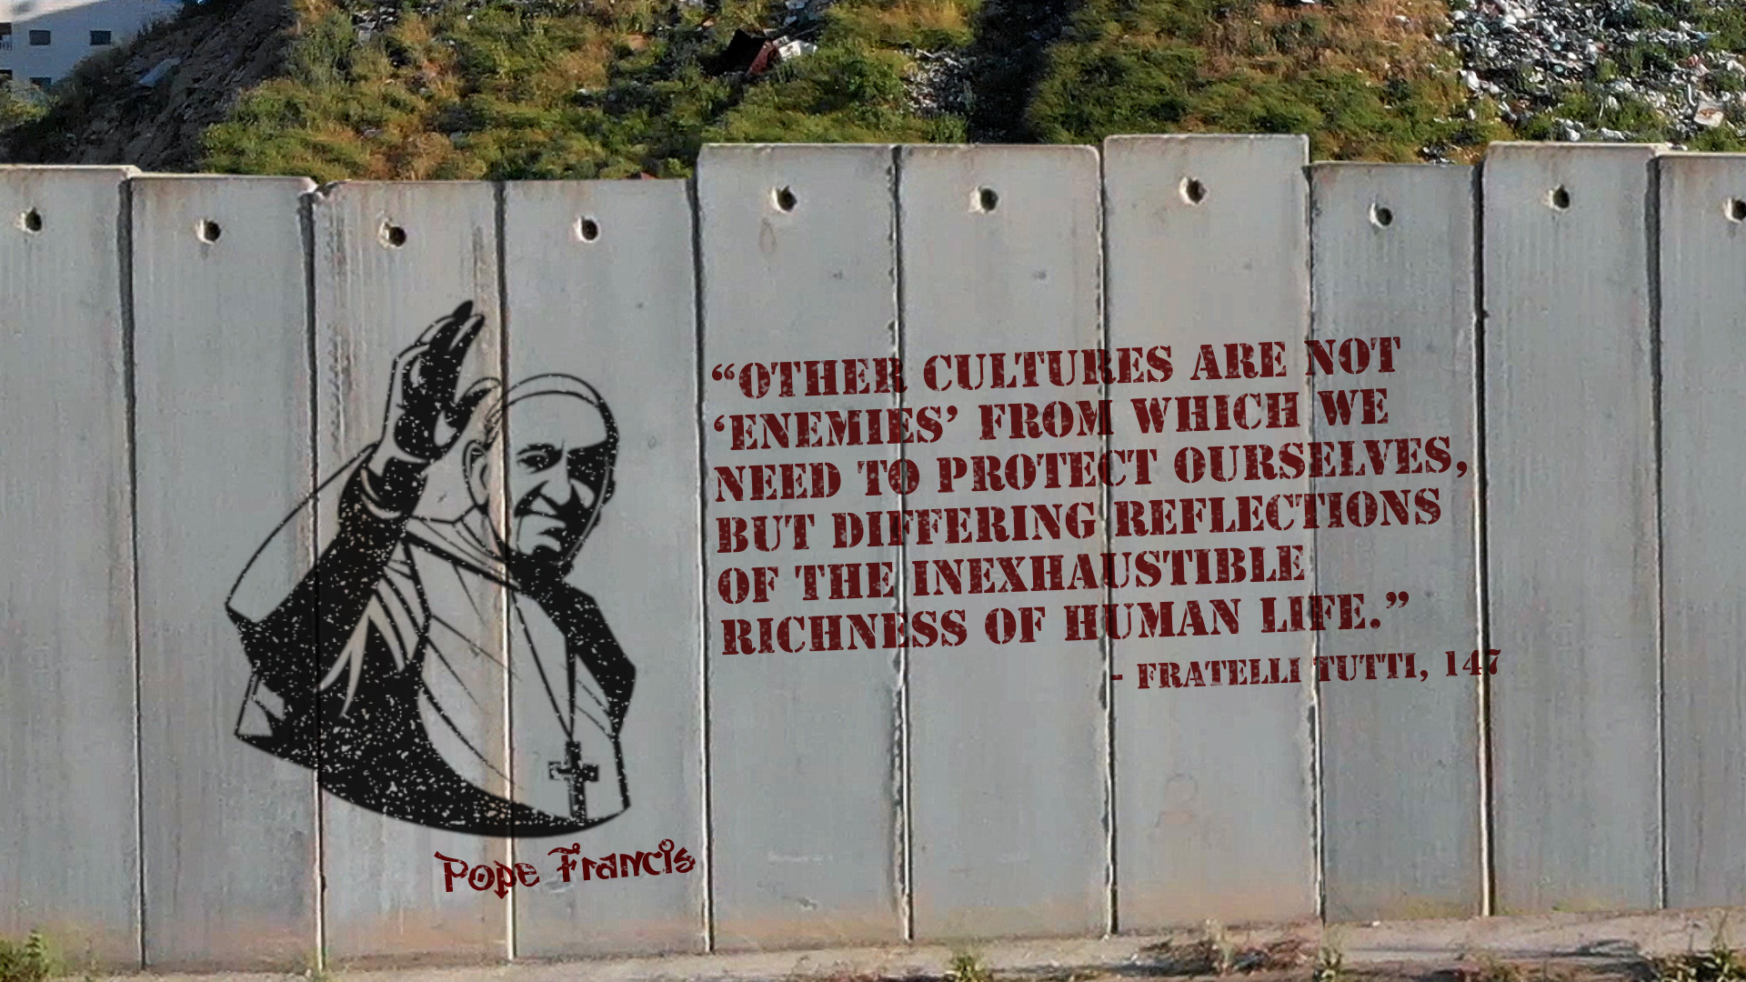
Q: What does Pope Francis mean?
Do you agree?

Slide 24
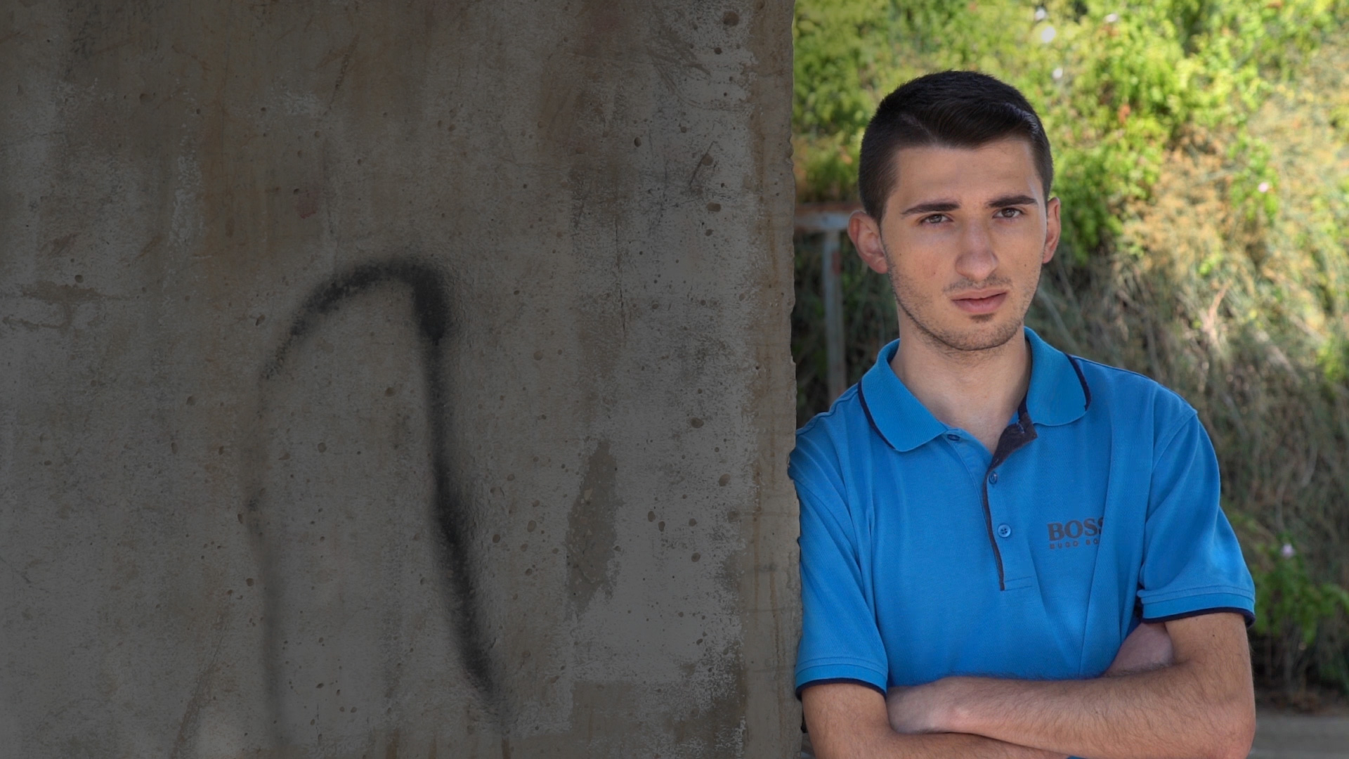
ELIAS’ QUESTIONS FOR YOU
Who am I?
Is the history of my people important to me today?
THOUGHTS TO TAKE AWAY
What has shaped your own perspective
and identity?
What might change your perspective?
Was your perspective (opinion) changed today?
If so, how and why?
Why is it important to be able to shift our perspectives – to stand in someone else’s shoes?

Slide 25
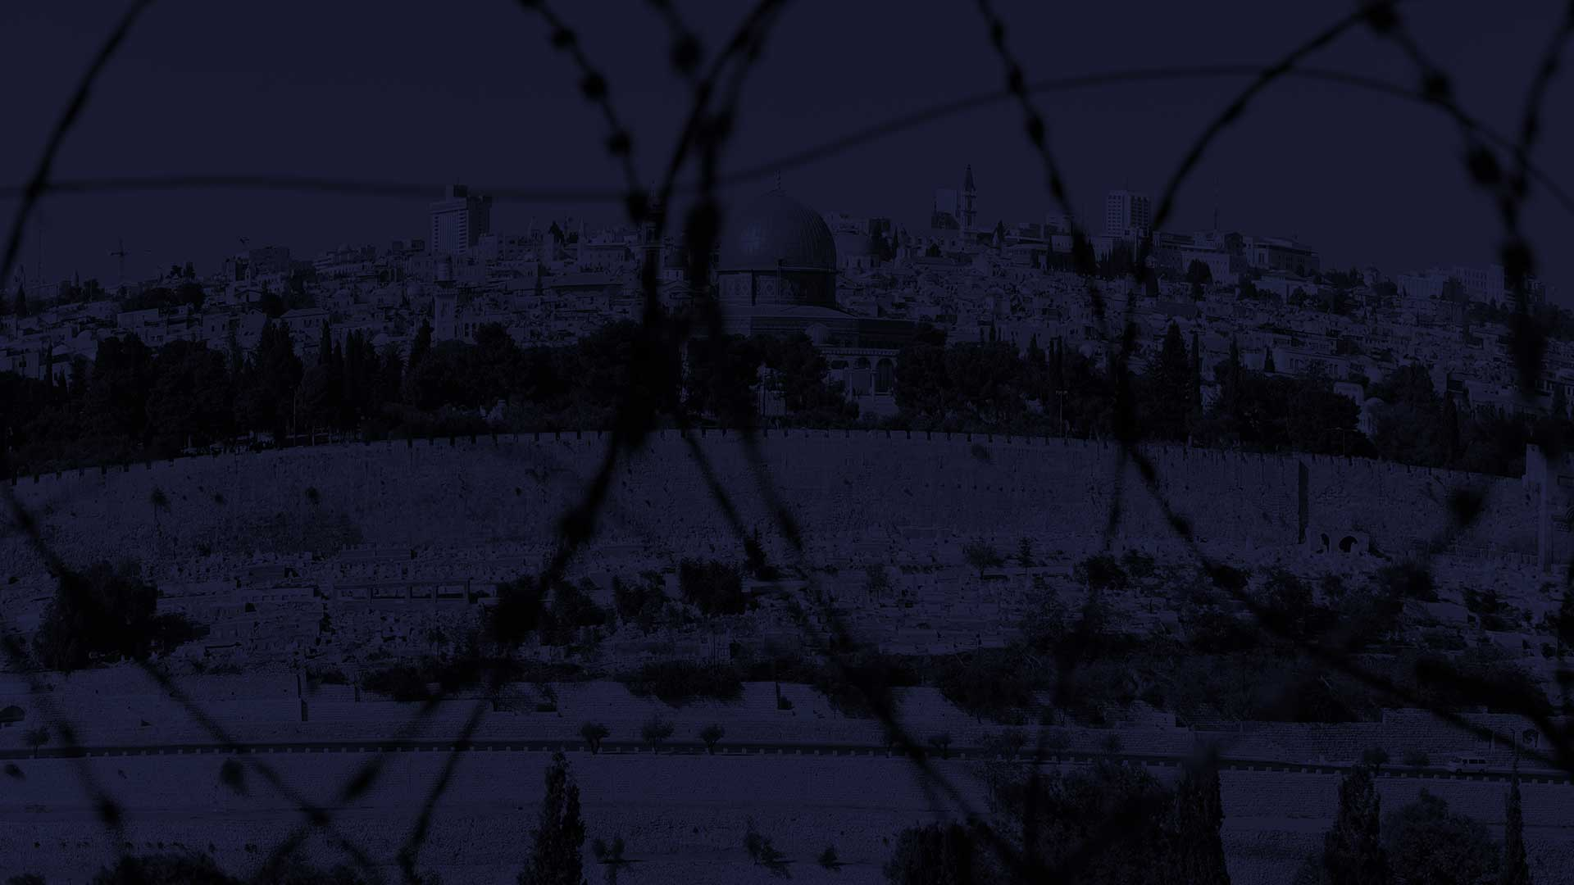
CAFOD IN THE HOLY LAND
In the occupied Palestinian territory CAFOD works with young people from different backgrounds like Elias and Amal, to challenge negative stereotypes. By meeting and listening, they have learned to understand each other’s viewpoint.
In Israel CAFOD helps school leavers like Maayan and Hiba learn the history of the conflict and explore what discrimination means to the people of different cultures who live in Israel. The aim
is for them to help build a future Israel where everyone has a voice – whatever their background.
CAFOD hopes this work will empower young leaders who can take action for a more peaceful and just society for everyone in the Holy Land.

Slide 26
EXTENSION WORK
Write a reflection about your identity as a young person in the UK – where do you feel you belong and why? Think about your family, other groups you belong to in society, your cultural background. What obstacles and opportunities do you see to being able to live a full life?
Find out more about CAFOD’s work in the occupied Palestinian territory and Israel at cafod.org.uk under ‘About us’. Click on ‘Where we work’.
By campaigning and fundraising with CAFOD you can help to defend and uphold the rights of people around the world who experience injustice. Find out more at cafod.org.uk/getinvolved

Slide 27
The Holy Land
The Catholic Agency for Overseas Development (CAFOD) is the official aid agency of the Catholic Church in England and Wales and part of Caritas International. Registered charity no. 1160384. Company limited by guarantee registered in England and Wales number 09387398.
This publication was produced with the financial support of the European Union. Its contents are the sole responsibility of CAFOD and do not necessarily reflect the views of the European Union.

