Slide 1
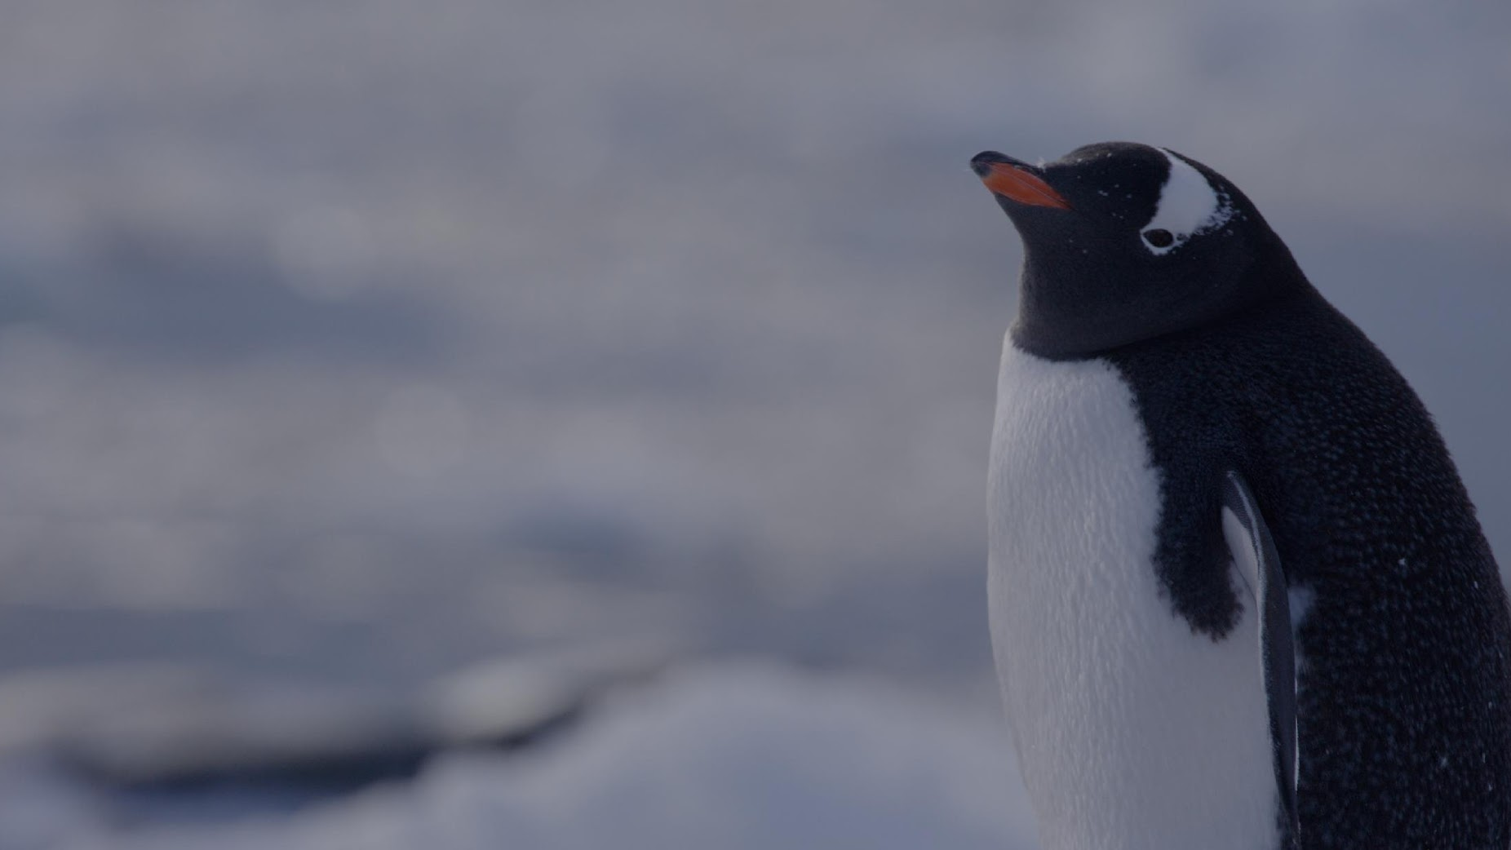

1st December is
ANTARCTICA DAY

Slide 2
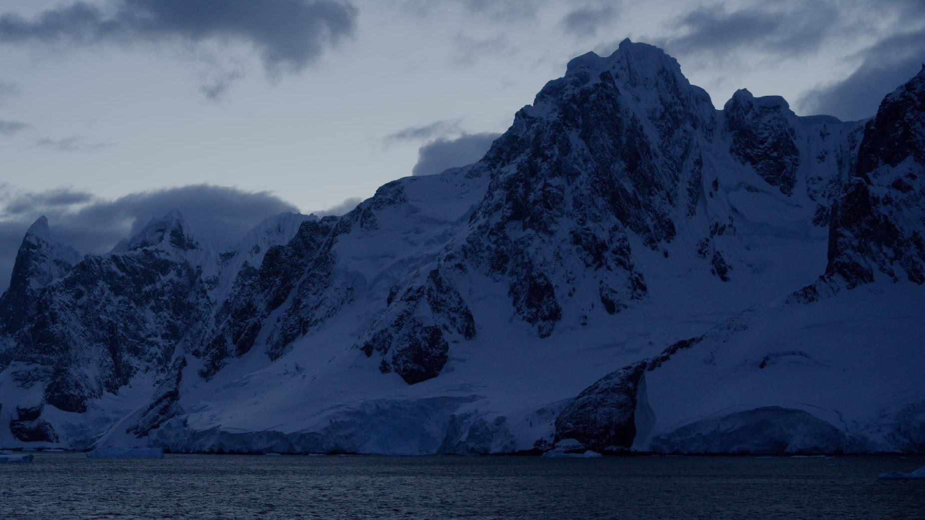
“…a natural reserve, devoted to peace and science”.

Slide 3
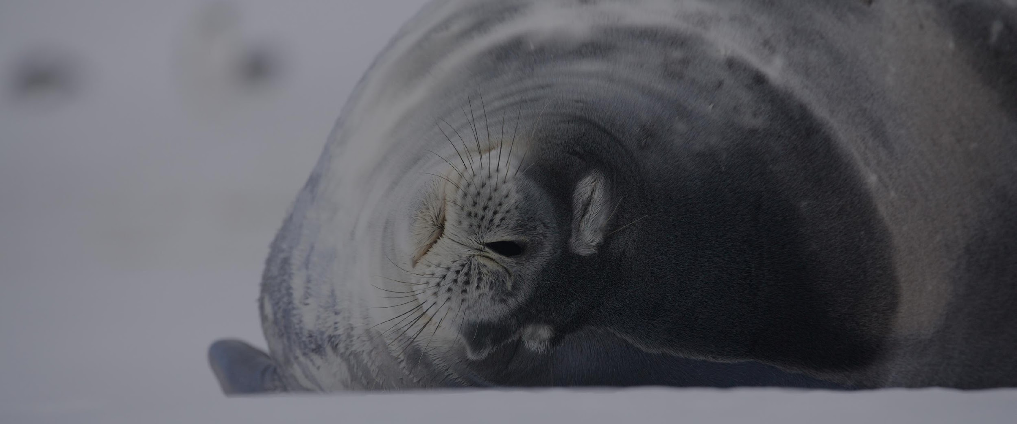

Slide 4
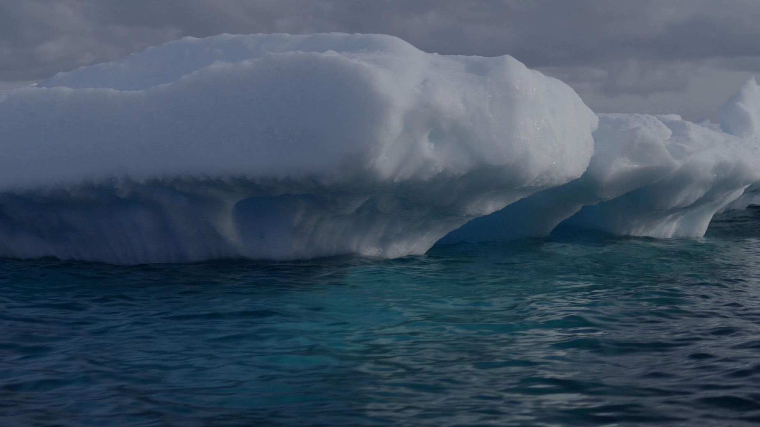
Antarctica is being impacted by climate change.

Slide 5
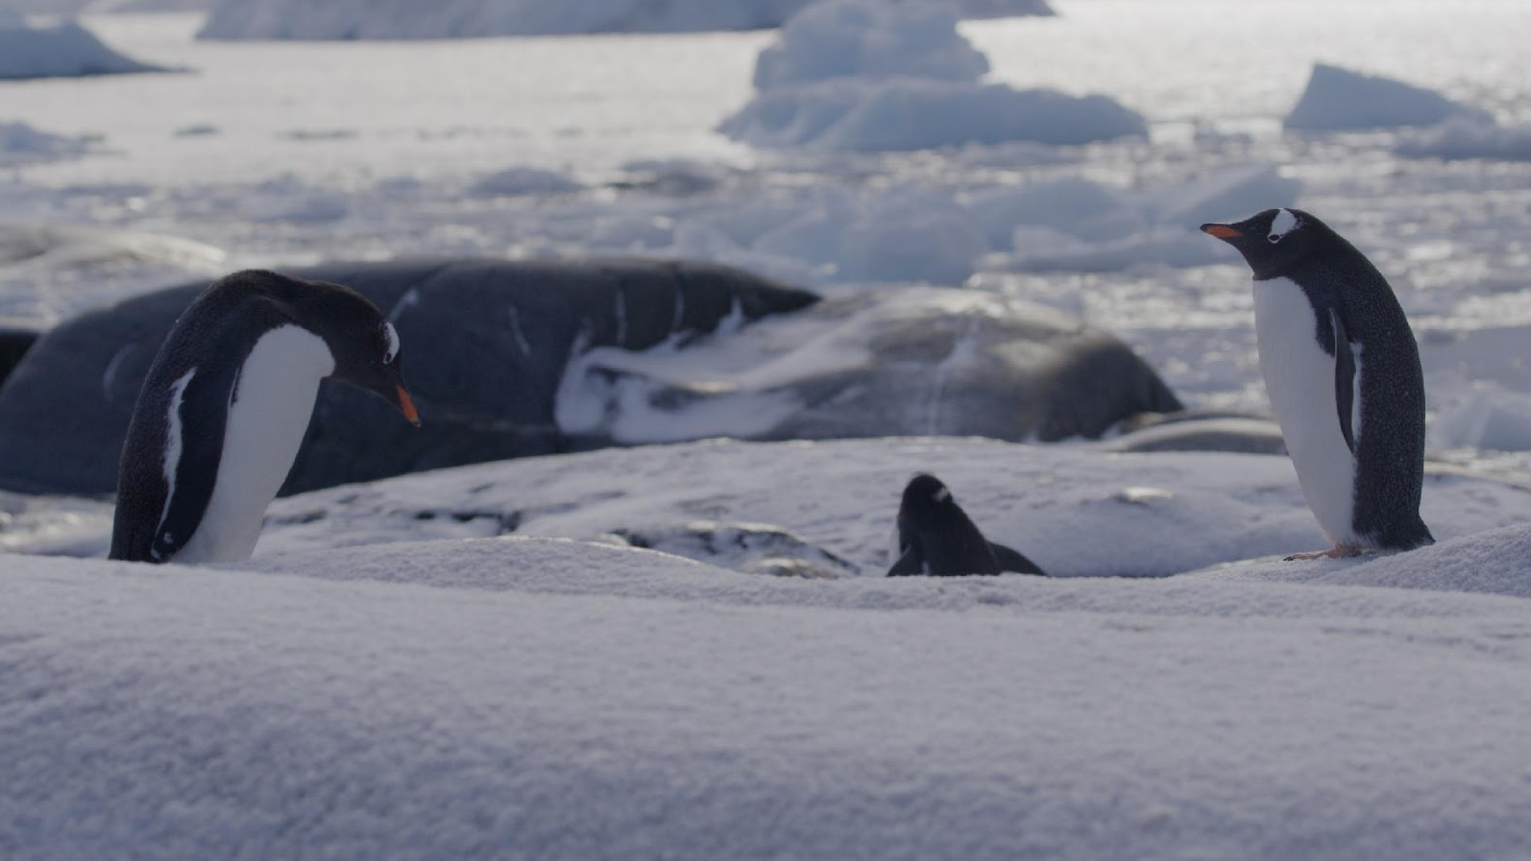
Food sources, homes, and safe places to raise families are all at risk.

Slide 6
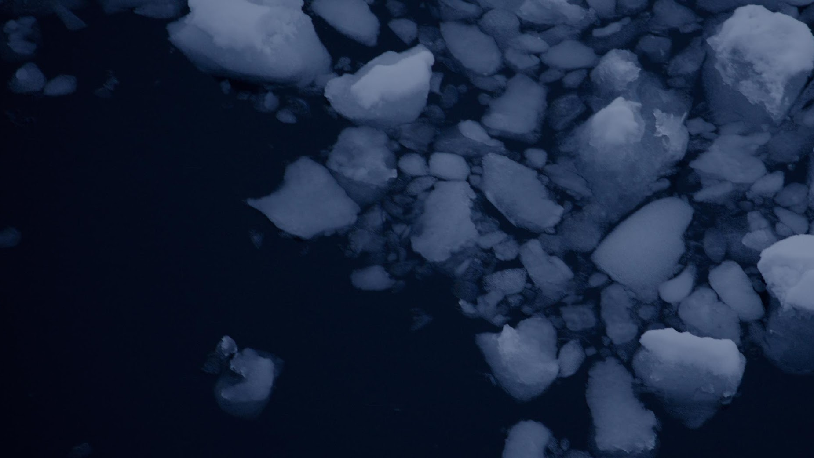
Our actions make a difference.
We can treat the planet as we would like to be treated.

Slide 7
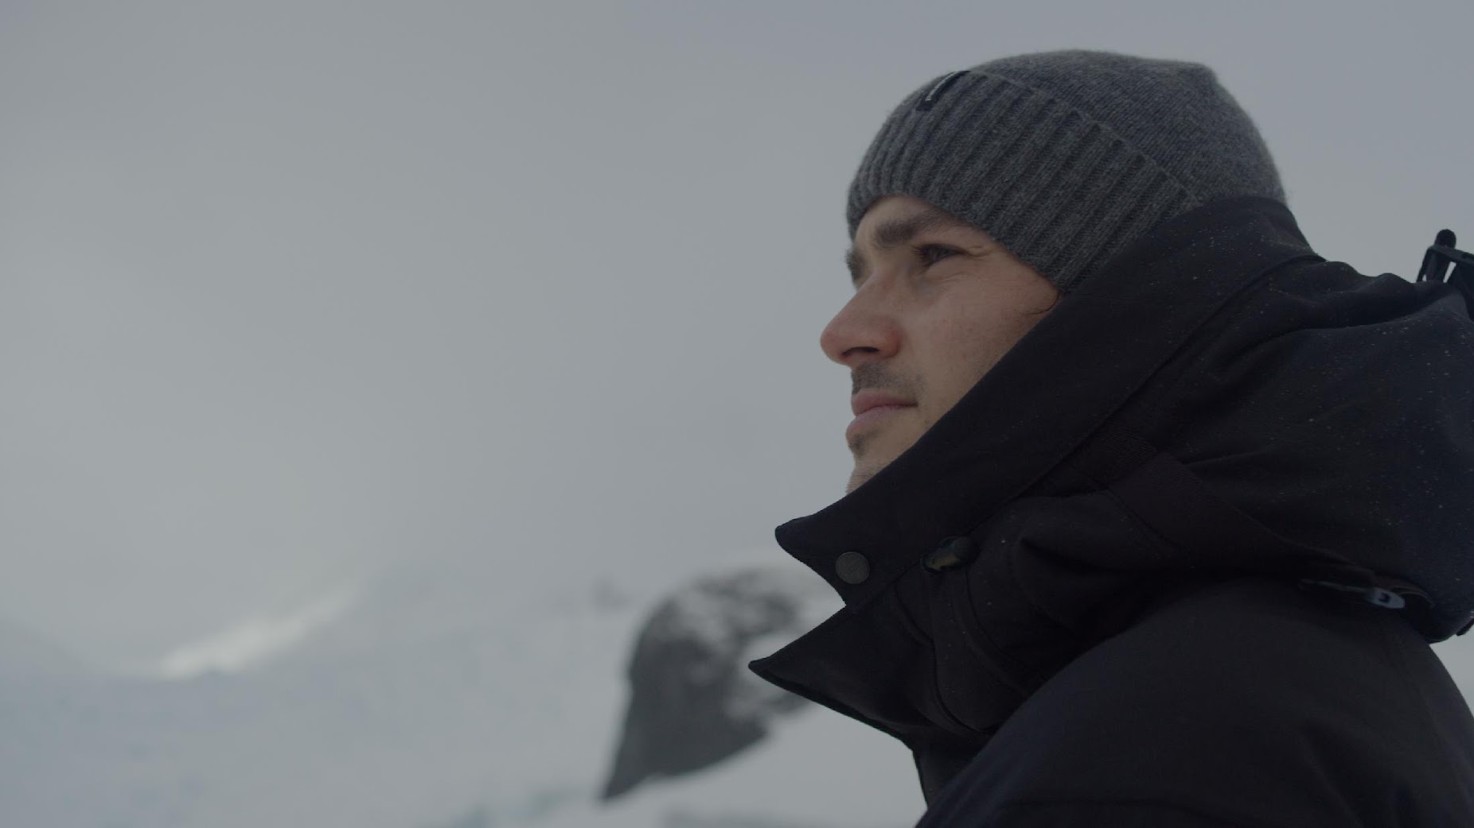
How can you use your voice and your actions to make a difference to Antarctica?

